Slide 1

Community-led Stewardship Support
www.communityfirst-stewardship.org

Slide 2
Placemaking Charter
People, community and local services
Engagement and collaboration
Building and releasing capacity and taking action
Supporting social and not just physical infrastructure.
Lasting results - legacy

Slide 3
Stewardship principles
Not pro or anti-development
Judge proposals on their own terms
Do not support unplanned development
Advocate on behalf of communities
Support communities when development happens

Slide 4
Bespoke Stewardship Solutions
NEGOTIATION AND PLANNING Scope, scale, phasing of assets Planning advice Financials: endowment, developer contributions | ASSET MANAGEMENT SUPPORT Green, blue, open space etc. Community buildings Community-led housing etc.
DEVELOPING THE STEWARDSHIP VEHICLE Identifying pioneers Visioning Outreach and engagement | LEGAL Type of body Governing Documents Asset transfer

Slide 5
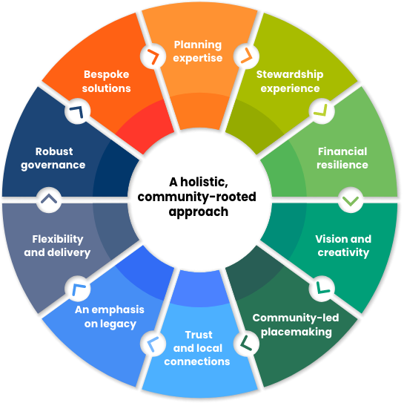
The Stewardship Wheel

