Slide 1
Development Pressures
The planning system is creaking under the pace of change.
New housing is developing its own momentum with implications for social infrastructure and impacts on biodiversity and nature.
Speculative housing is often of a scale that is out of keeping with the existing communities.
Policy at national level is attempting to co-ordinate delivery of a range of uses that compete with each other.
Governments wants a million homes built in this Parliament.
.

Slide 2
Government reforms
.
Michael Gove
“[We] will be making further changes to the planning system to place local communities at the heart of the planning system.”
These reforms will help to deliver enough of the right homes in the right places and will do that by promoting development that is beautiful, that comes with the right infrastructure, that is done democratically with local communities rather than to them, that protects and improves our environment, and that leaves us with better neighbourhoods than before.”

Slide 3
Pressure on Land-use
Making the Most Out of England’s Land - (House of Lords Landuse in England Committee)
Nature and biodiversity restoration, development and infrastructure, energy generation, carbon sequestration and public access and well being. calling for a Land Use Commission to provide a framework for decision making.
Multifunctional Landscapes Report - (Royal Society)
An area the size of Northern Ireland would be needed to meet current policy targets by 2030. An additional area twice the size of Wales would be needed to achieve them by 2050.

Slide 4
Land – policy and pressures
CURRENT UK POLICY REQUIREMENTS – COMPETING PRESSURES
300, 000 new homes a year
Conserve 30% of UK land for nature by 2050
Scale up crops for energy to 23,000 HA a year by mind-2020s
Increase woodland from current 13.2% to 17% by 2050
Does not include areas explicitly needed for greater climate resilience, including extending flood meadows, significant uptick in woodland as a carbon sink and so forth.

Slide 5
Ongoing and incoming pressures
Global Issues including climate change is over time going to impact food and energy security
8.7% of England is developed land
63.1% is agriculture
20.1% is forestry, open land and water
4.9% is residential Gardens
6.8% of all land is within Green Belt

Slide 6
The Housing Question
Government proposed 300,000 new homes a year are needed to cater for the growing levels of demand.
A conurbation the size of Birmingham every couple of years.
The larger sites will be urban extensions, Garden Village/Eco Towns and new settlements - significant contribution will come from minor sites which do not provide affordable housing.

Slide 7
Land, infrastructure and natural assets
According to The Planner, 8.7% of land in England is developed circa 1.135m hectares - suggests there is a lot left over for further urbanization ideally on greenfield sites and in areas where there is already good infrastructure.
The lowland areas are mainly the arable lands where the developers will seek to secure land, including various natural assets that are non- designated. The food security issue is also an important matter to be factored in.

Slide 8
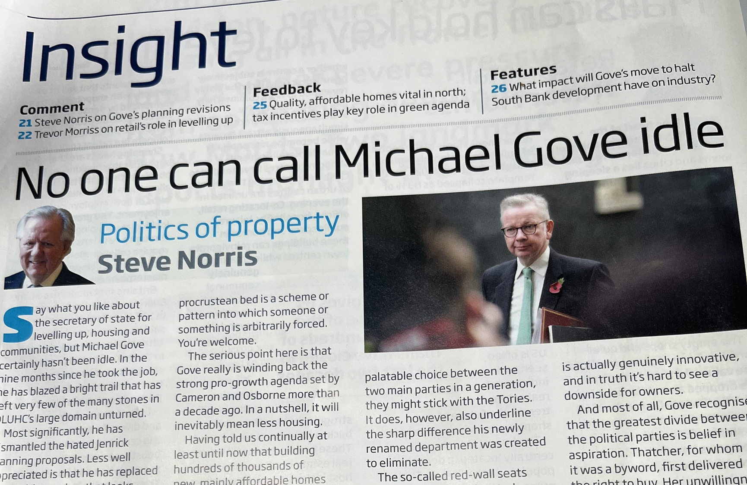
Legislative and policy evolution
The Levelling Up Bill
Social Housing Regeneration Act
Relaxation of Permitted Development Rights regime
Biodiversity Net Gain provisions
NPPF

Slide 9
Community Impacts
Austerity and cuts: decline of local resources (e.g. buses, schools)
Pressure on local Infrastructure: new uses (e.g. solar farms)
Climate Change and biodiversity loss
Housing issues: lack of affordability

Slide 10
Responding to the pressures
Neighbourhood Planning
Extent and Scope
More democracy
Funding
Weight attributed

Slide 11
Challenges and opportunities
Climate Change
Biodiversity Net Gain and Nature Recovery
Stewardship

