Slide 1

Community Development and
Social Sustainability:
The London Development Trust Approach

Slide 2
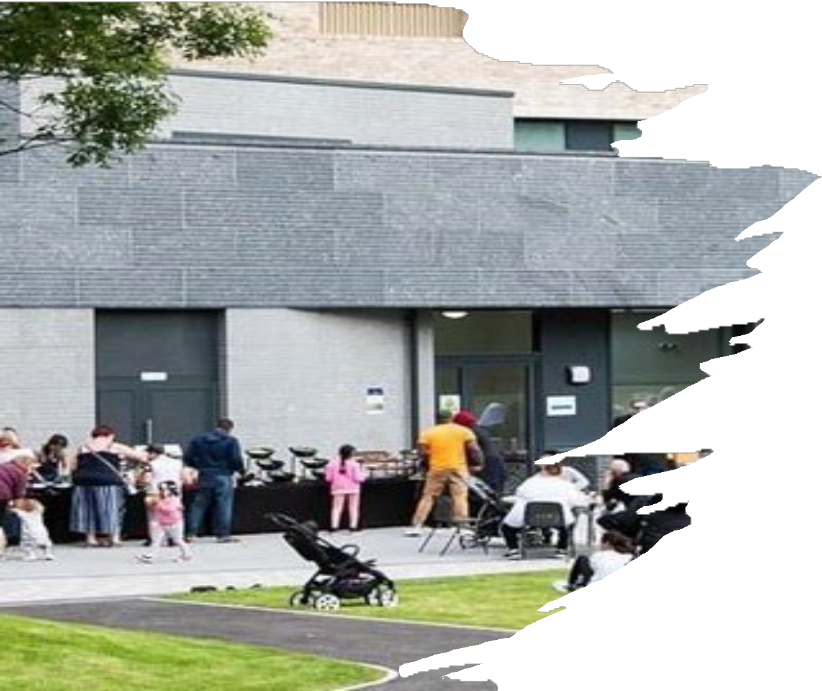
London Development Trust
              Charity and social enterprise operating for over 15 years
    Helping Developers to build places where people live happily
Direct provision of community development on regeneration
Developed a unique approach to Social Stewardship
Expert consultancy on:
                - Impact Measurement and Data Management
              - Innovative Community Consultation Techniques
              - Community Building Design & Operational Planning
              - Business Planning for Community Organisations
              - Creative research on social infrastructure, environment
              and sustainability

Slide 3
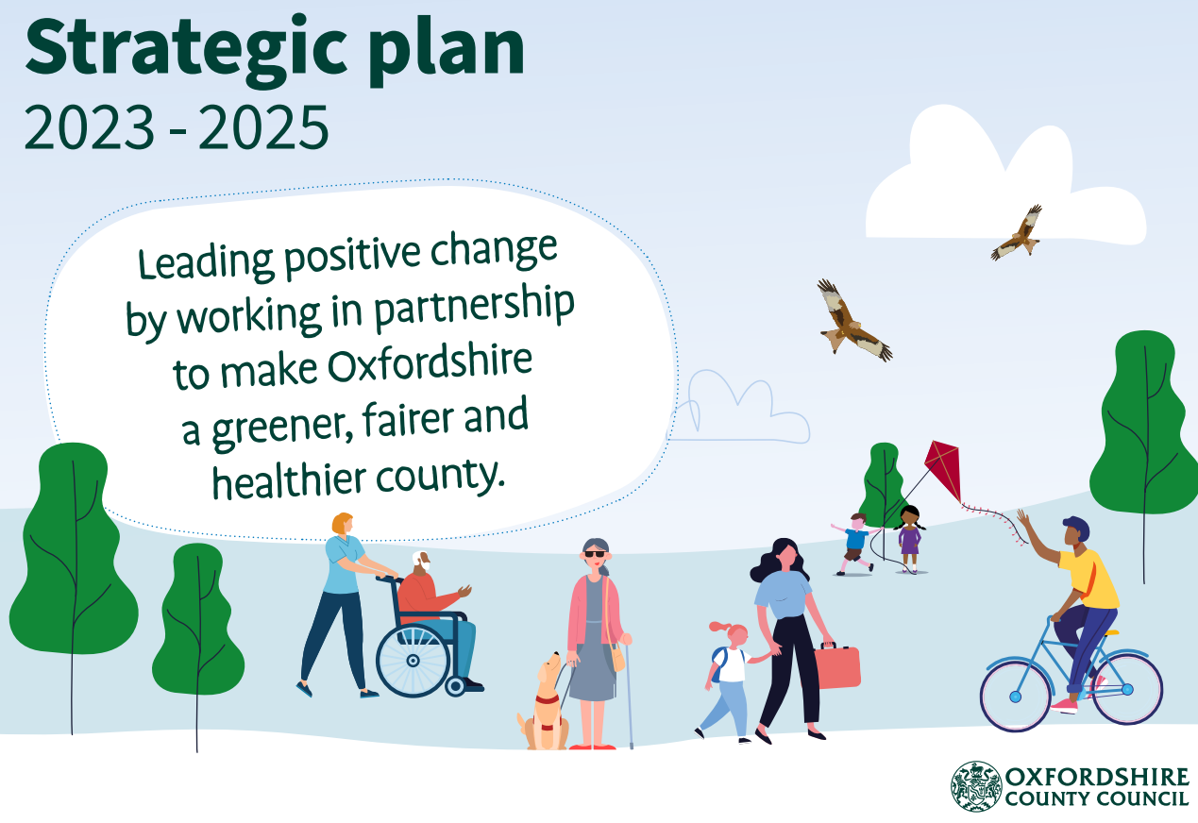
Helping to build places where residents live
‘Happy Lives’ - Our Mission
The places we live in have a profound impact on our health and wellbeing. Significant gains in population health can be achieved by working in partnership to improve the built, natural and social environments.
improved resident access to services
improved resident health and life expectancy
improved mental health
improved community cohesion
improved environmental consciousness and behaviour change
increased economy, and new jobs and training opportunities
Happiness Can Be Measured!

Slide 4
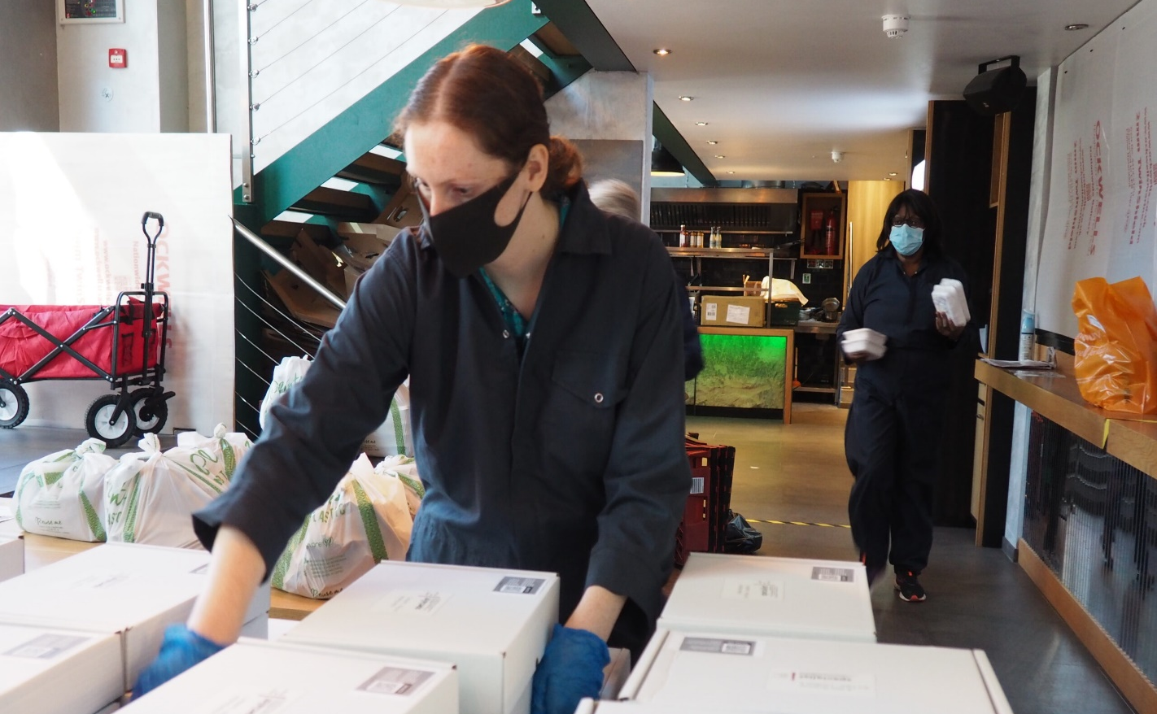
Happy places are created through holistic community development
A holistic and joined-up approach to community development is needed to address challenges related to health, inequality and social inclusion/exclusion, social cohesion, employment and climate change.
The 5 Keystones provide those involved in Placemaking a conscious, systematic, adaptive approach to community development. This approach creates sustainable and vibrant communities that are resilient to urban change.

Slide 5
Keystone 1 - Connection
Connect with what exists in the area (services, infrastructure, natural assets, activities, knowledge) – no need to reinvent the wheel.
Look outside the red line.
Connect new and existing residents through projects or community platforms. Make it easy for people to connect.
Place is a many layered concept – connect with an area’s past and recognise diverse relations to place
Support connected neighbourhoods that enable joined-up working

Slide 6
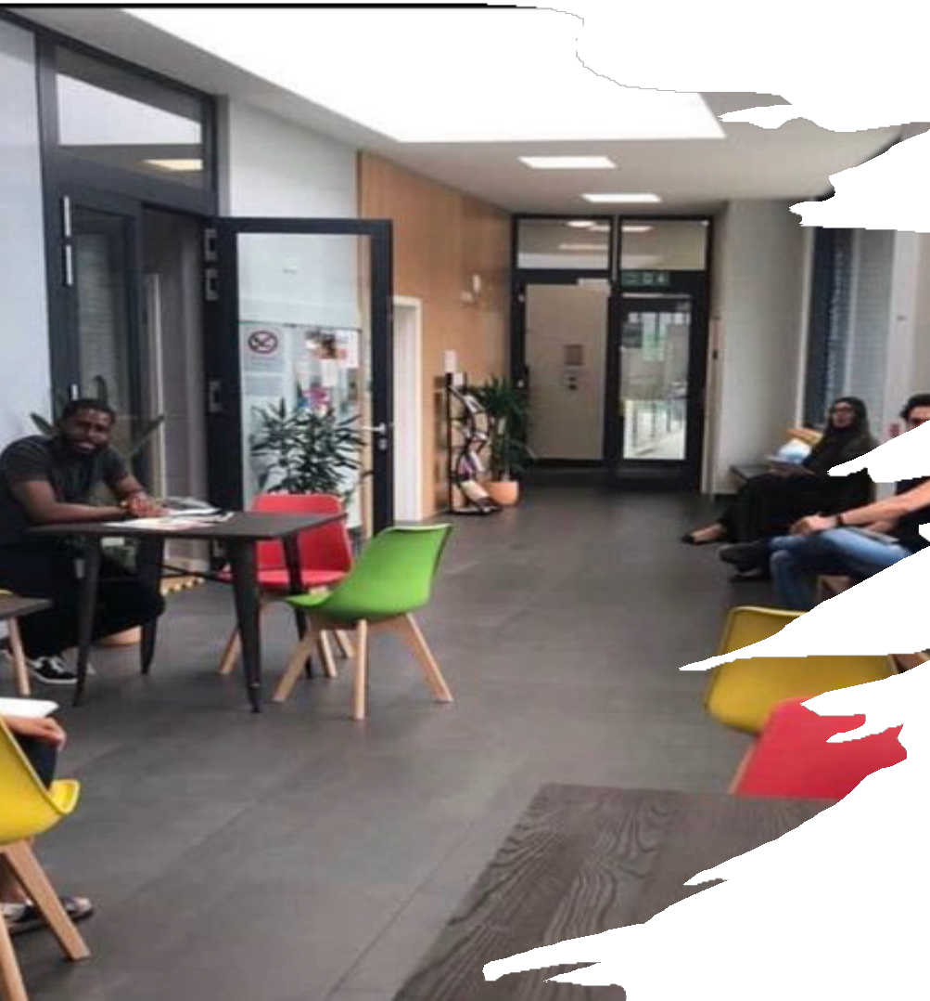
Keystone 2 - Spaces
Design, provision and management of safe and accessible spaces for the community's benefit.
Utilisation of asset-based community development (ABCD) and temporary spaces like pop-ups, building sites, community gardens, and public areas – provides long term revenue.
Encouragement for community involvement in managing blue/green spaces to address climate change anxiety and mental health concerns.
Opportunities for individuals to connect, share ideas, and collaborate on projects for community benefits.
Emphasis on community involvement and local residents taking ownership of spaces for positive neighbourhood change.

Slide 7
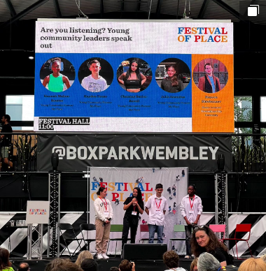
Keystone 3 - Influence
Commitment to being data-driven - using data to demonstrate impact and influence policy makers
Guiding monitoring and evaluation through ‘Theory of Change’ approach, ensuring stakeholder engagement
Development of standards to identify gaps, weaknesses, and unkept promises
Utilisation of tools for real-time data collection, consultation, and participation reporting ensuring accurate measurement and comparison
Understand the area through baseline research and community needs assessments
Empowering local residents to hold policy makers accountable and advocate for positive change in neighbourhoods
LDT’s Young Pioneers speak at this year’s Festival of Place at Wembley project movie @ https://youtu.be/-BFohGaf7do

Slide 8

Keystone 4 - Organisation
Running a sustainable organisation committed to community development and social sustainability
Diversification of income streams, dedicated team, and core values of collaborative working and innovation
Leadership by a board with relevant experience and local connections, governed by company law
Implementation of policies, appropriate financial reporting, and management practices
Collaboration with regeneration partners, developers, and housing associations
Emphasis on employing local professionals and building community capacity
Establishment of trust to attract funding for community investment.

Slide 9
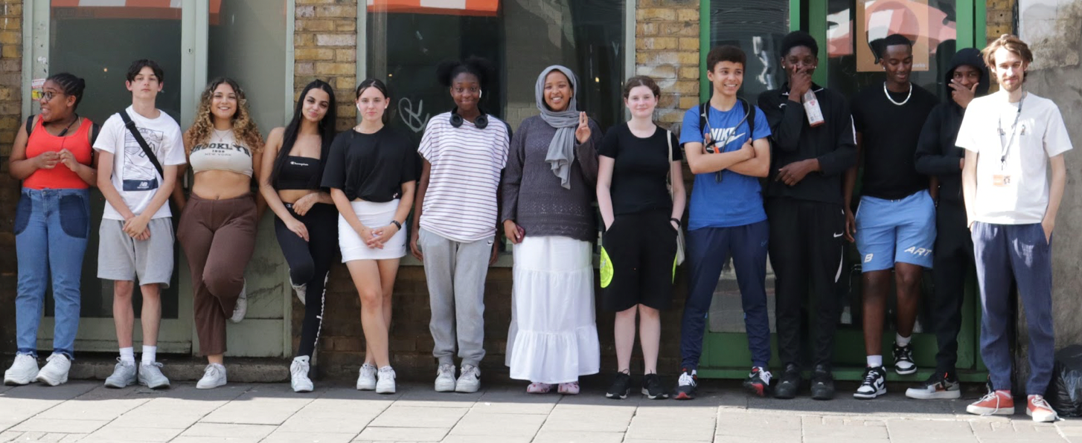
Keystone 5 - Empowerment
Empowering communities and individuals
Provision of expertise, training, resources, and finance to support people's goals and aspirations
Assistance in securing employment, training, health, volunteering, and enterprise development opportunities
Establishment of a network of local voluntary sector groups for community sustainability
Support for these groups in areas such as insurance, fundraising, and setting up bank accounts
Inclusion of these groups in voluntary sector organisations with rules, goals, and access to small grants

Slide 10
Our Consultancy Offer
Advising on Bid Development
Community development and social stewardship is high on local authority and others agendas when deciding who to partner with on housing developments.
LDT can provide expert written input to your teams bids to win new sites.
With over 30 years’ experience of providing community development on large regeneration sites our staff can give your bid the edge on social stewardship planning
Community Facility Design and Business Planning
Consultancy on the design of community facilities, including neighbourhood centres and co-working spaces giving insight into day-to-day management of a centre,
Support creating business plans covering income generation and expenditure costs based on real community centres
Consulting the Community
LDT is expert at community consultation and co-produced research. We can provide a range of engagement tools, from online surveys, to running events which encourage members of communities to engage in consultations and influence placemaking.

