Slide 1

Citizens in the lead: sustainable community-led projects and initiatives
Emily Lewis-Edwards co-CEO, CFO
September 15, 2023

Slide 2
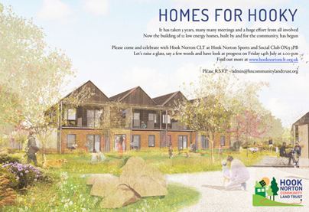
Community-led stewardship
Why does it need to be community-led?
Why is it important to us?
We have influence on the things that matter to us.
A greater sense of belonging and ownership – a better chance of sustainability.
Wider health and wellbeing impacts.
Stewarding our environment.

Slide 3
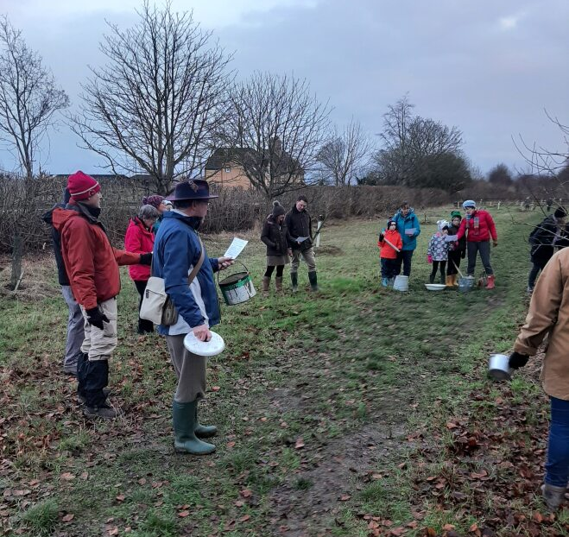
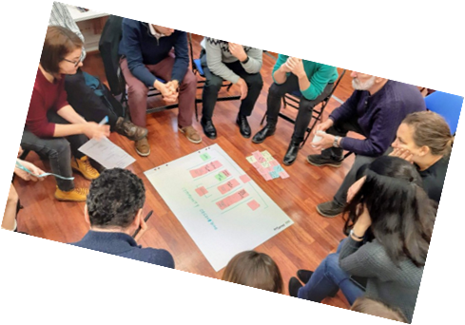
What examples do we have in Oxfordshire?
Know your community, know your assets: community mapping.
Community-led housing.
Placemaking/ place-shaping initiatives.
Green spaces/ environmental initiatives.

Slide 4
The challenges and the opportunities
No community is perfect – use the ABCD approach
Finding the right people, skills and funding – hub and spoke model can help
Take community-led stewardship seriously – outside agencies to ‘invest in the process’ at the start

Slide 5
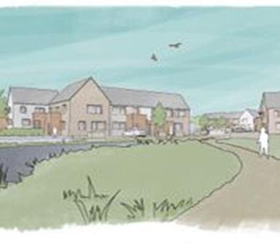
Community-led stewardship – the time is now!
For successful stewardship to happen we need:
Time to nurture – ABCD approach and time to get to know what is needed.
Support from outside agencies – needed at the very start of the process.
Allocated funds and resources – community-led isn’t a free option.

Slide 6
Oxfordshire is the home of long-term community-led stewardship
Thank you!

Slide 7
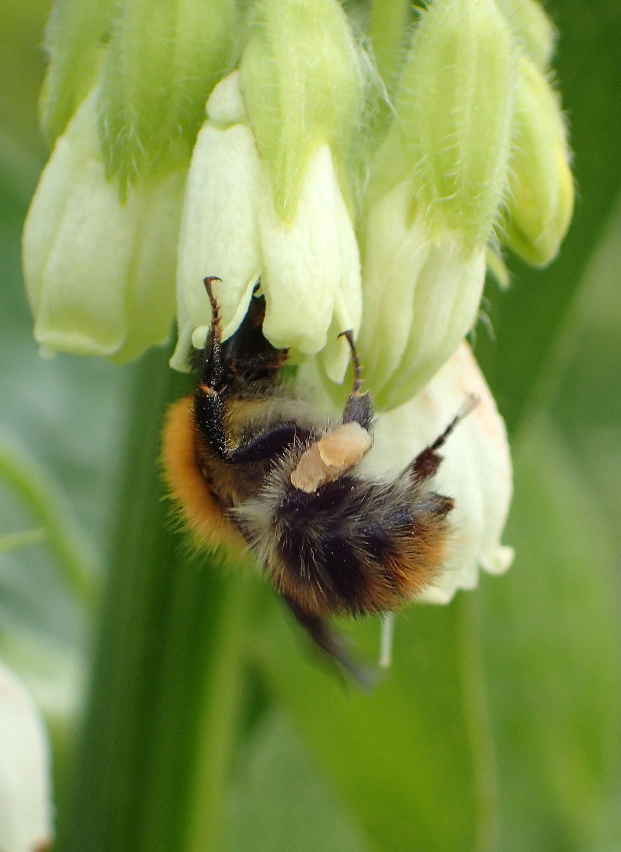
Community-Led Nature Recovery in Oxfordshire
Community-led Stewardship: Shaping Resilient, Sustainable Places – September 2023
Camilla Burrow, Chief Executive, Wild Oxfordshire

Slide 8
Camilla Burrow
Fifteen years experience working in the environmental conservation, data services and planning sector.
Chief Executive of Wild Oxfordshire since June 2020
Director of Thames Valley Environmental Records Centre 2011-2020
Ecologist Planner at Oxfordshire County Council 2007-2011
MSc (hons) Environmental Management & Technology
BSc (hons) 2.1 Biology
Member of Chartered Institute of Ecology and Environmental Management

Slide 9
Wild Oxfordshire
A charity seeking to create a more natural, resilient, and biodiverse Oxfordshire for the benefit of all.
We catalyse change by identifying needs, convening partnerships and unlocking opportunities for nature recovery action.
We collaborate with numerous individuals, communities and organisations; offering expertly curated and inspiring information, bespoke advice, and nature-based solutions.

Slide 10
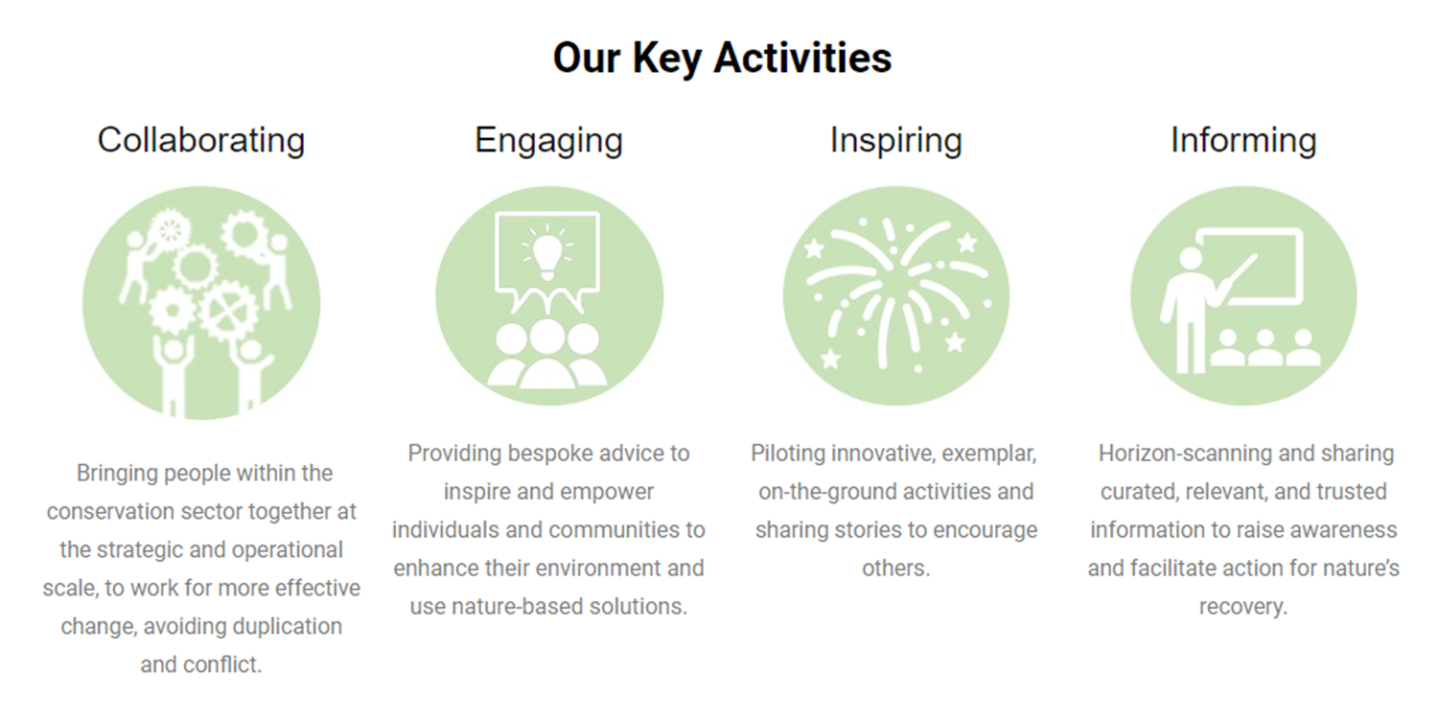
Wild Oxfordshire – what we do

Slide 11
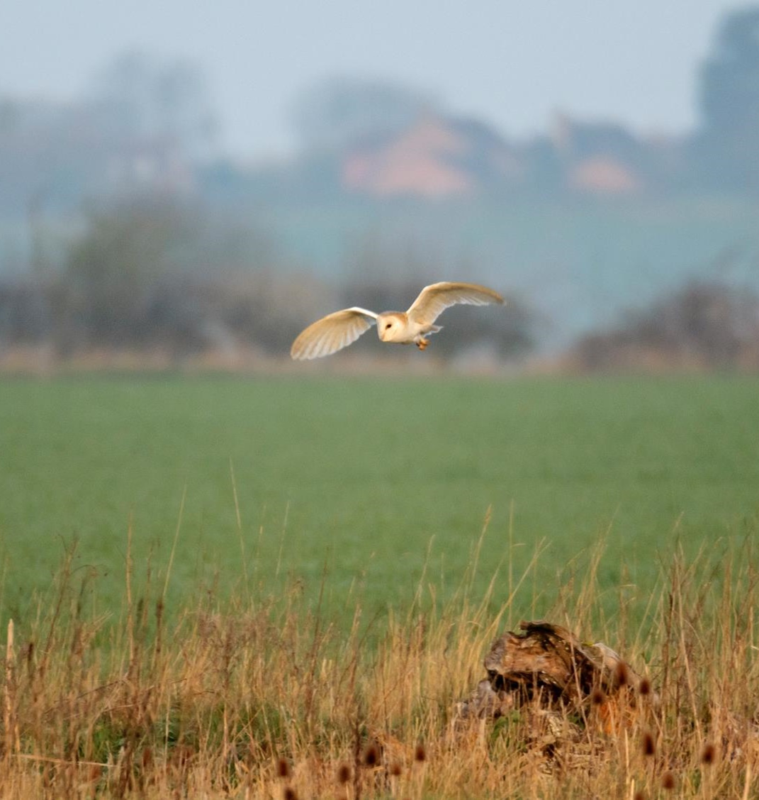
What is Nature?
Nature = Biodiversity
Biodiversity refers the great variety of life: the plants and animals that live in the air, on the land, and in wetlands, rivers and seas.
Conserving biodiversity is key to achieving sustainable development and intimately connected to environmental issues such as climate change, pollution and disposal of waste.

Slide 12
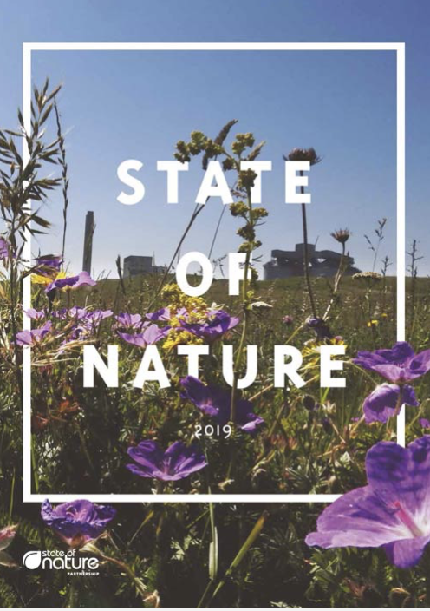
Why is action needed?
UK State of Nature Report 2019
Since 1500 in UK:
133 species have become extinct
Since 1970 in the UK:
> 50% of our species have experienced population declined
15% currently threatened with extinction
Since 2008
Public expenditure on biodiversity as a proportion of GDP has fallen by 42%
Biodiversity Intactness Index: values <90% indicate biodiversity has fallen below a threshold beyond which ecosystems may no longer reliably meet society’s needs.
Global average: 85% ‘intact’ UK 81% ‘intact’
UK rated 189th out of 218 countries assessed

Slide 13
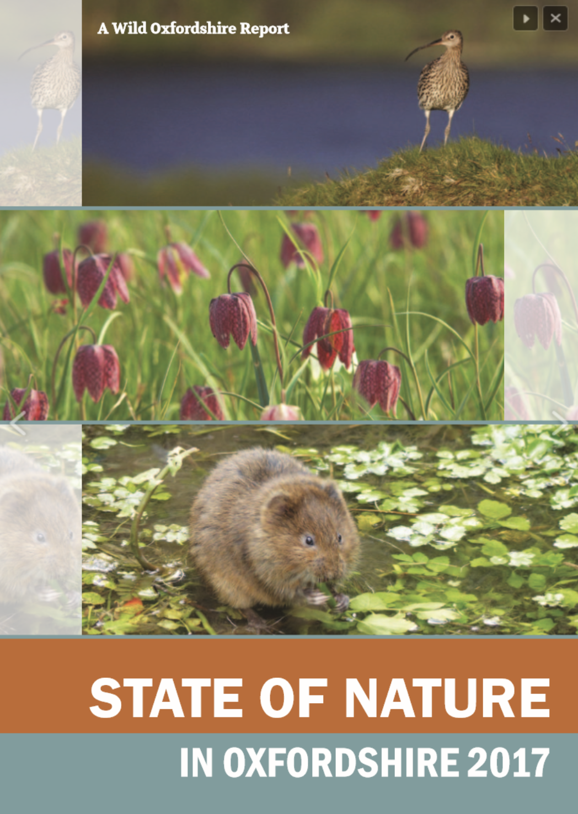
Oxfordshire
Key Findings
Widespread recent historical loss of species-rich semi-natural grasslands
There is a continued fragmentation and loss of connectivity across the county’s landscapes, affecting the future viability of habitats and species.
Key Action
Urgently create larger and more connected areas of high quality habitats
https://www.wildoxfordshire.org.uk/stateofnature/

Slide 14
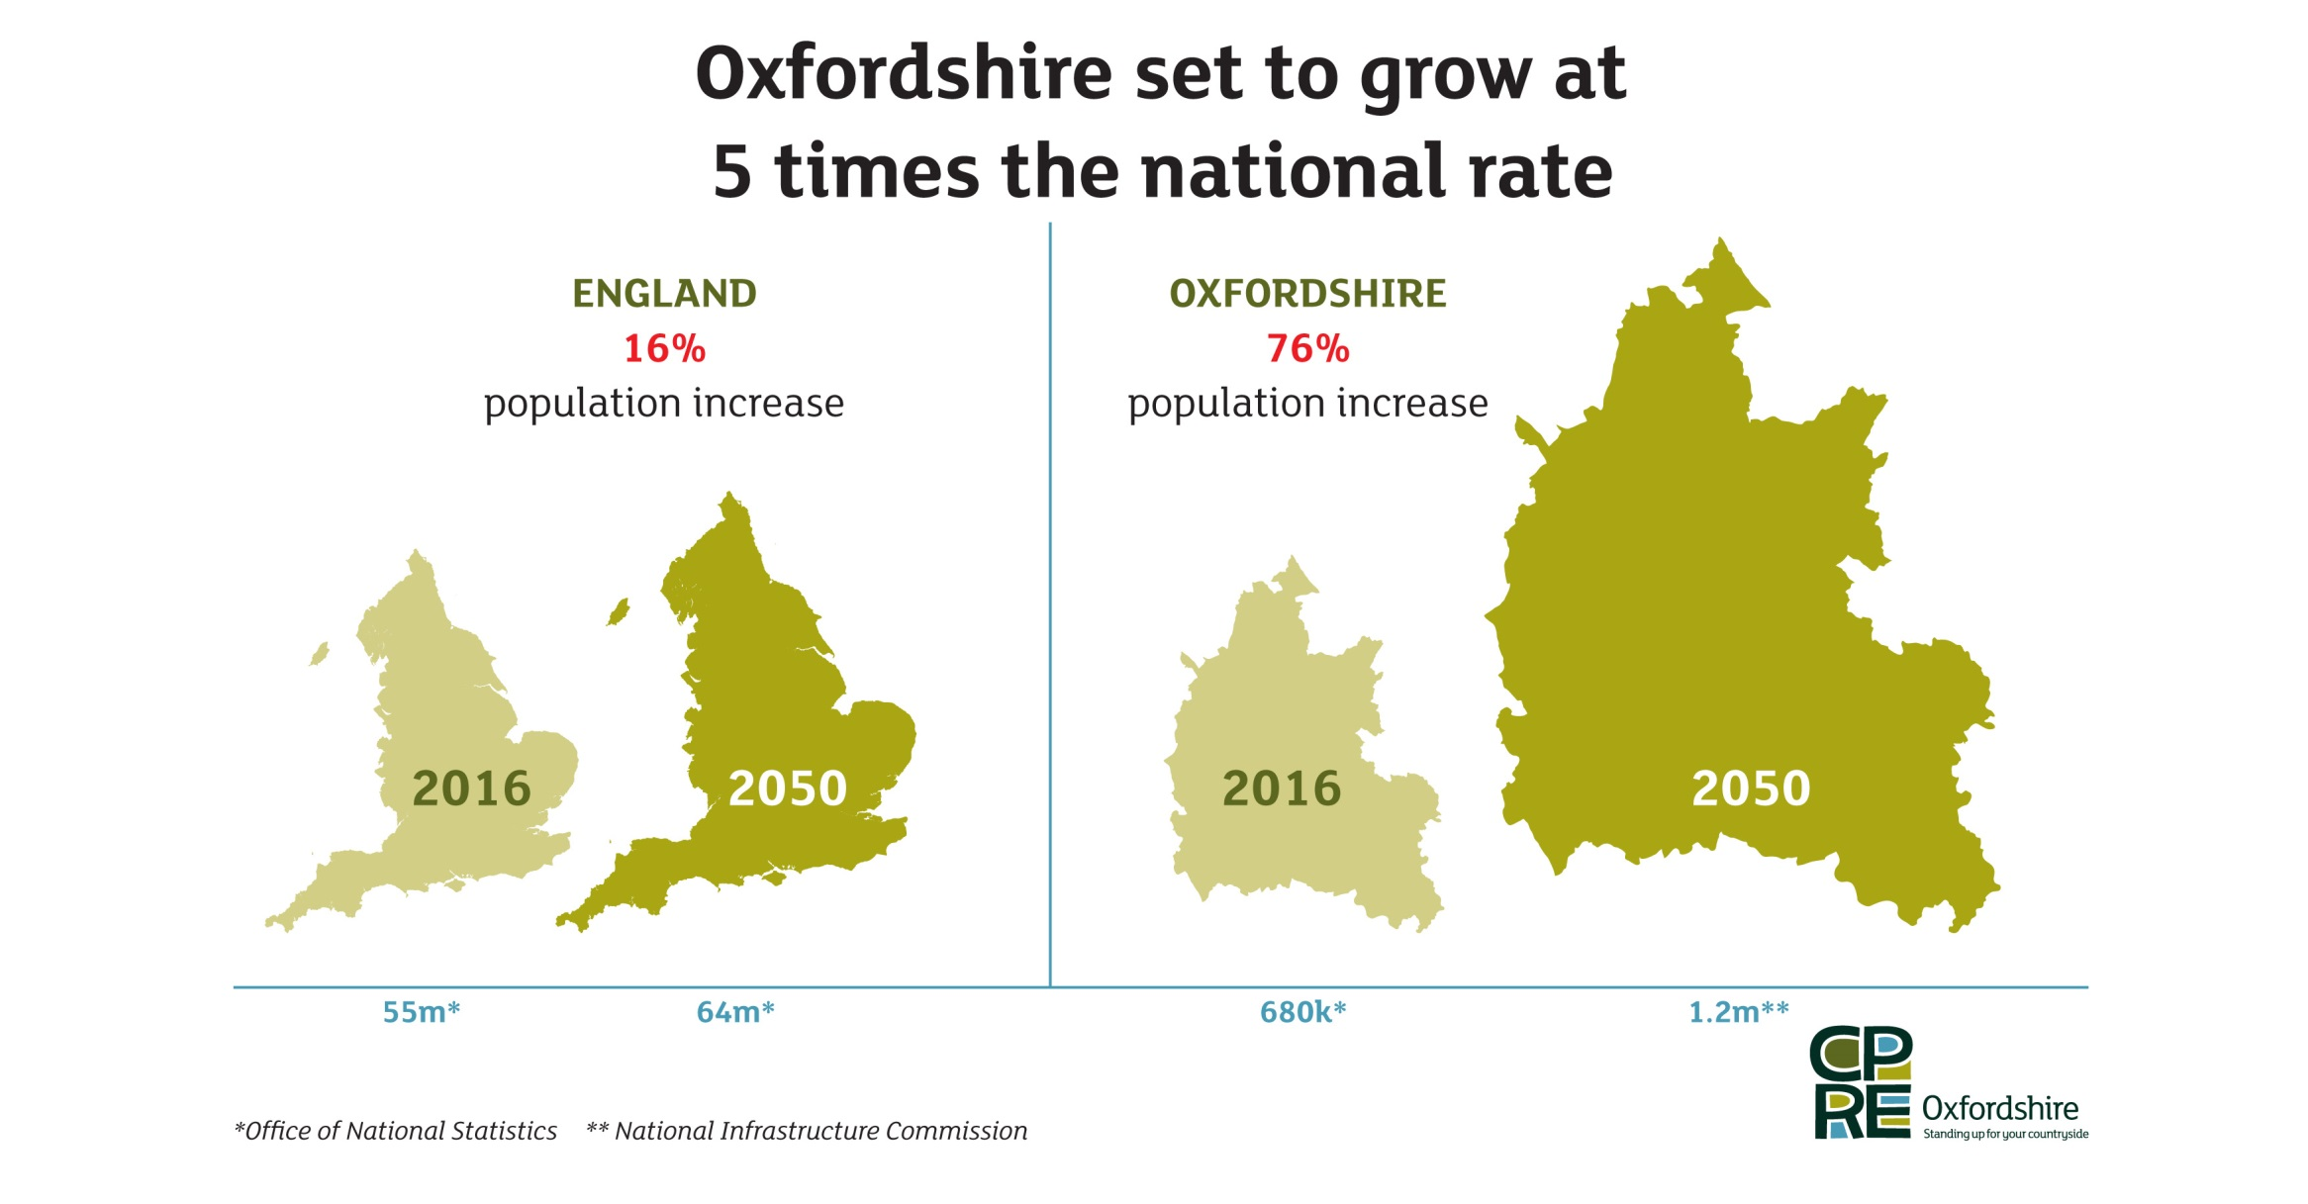
Catalyst for Action

Slide 15
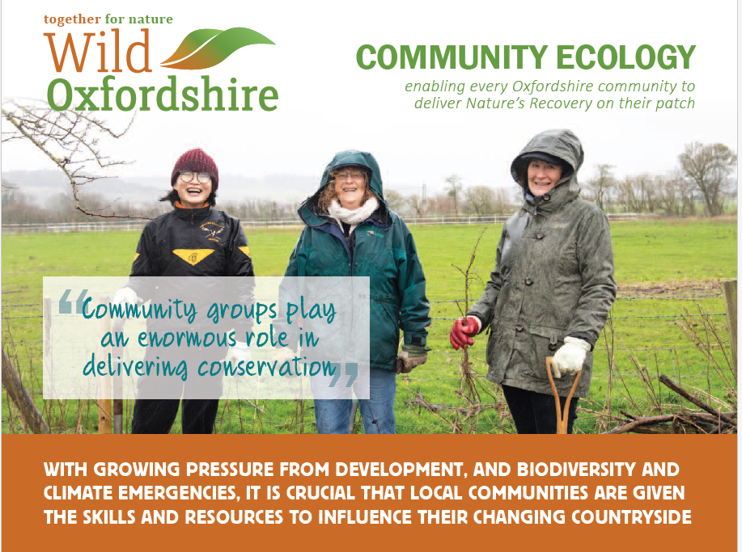

Slide 16
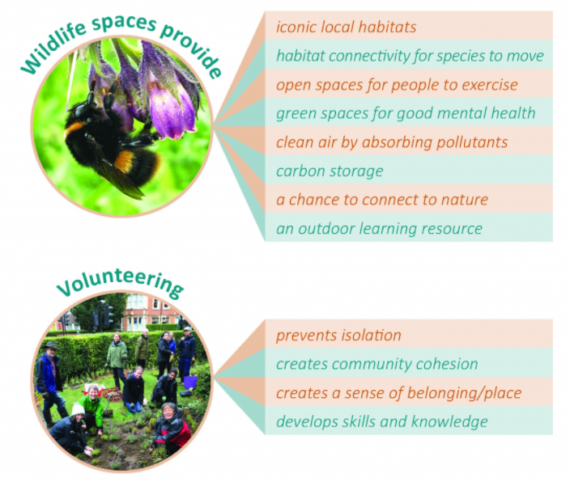
Why Community-Led Nature Recovery?

Slide 17
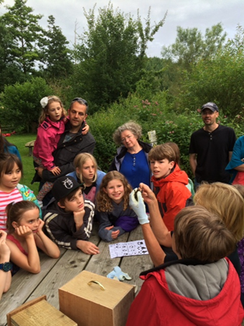
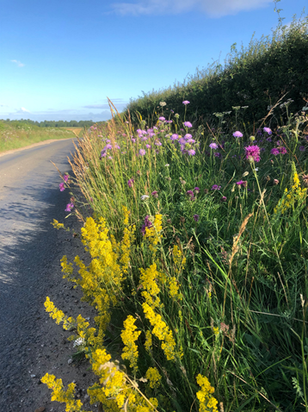
How do we achieve community-led nature recovery?

Slide 18
How do we achieve community-led nature recovery?
Bespoke ecology advice to parish & town councils and community groups to improve their patch for Oxfordshire’s habitats and species
Site visits by our Community Ecologist to do ecological surveys and create management plans, and link groups into county-wide initiatives, such as the Nature Recovery Strategy, Conservation Target Areas, river catchment partnerships, biological recording, and citizen science projects.
Talks on Nature’s Recovery and what councils and groups can do to help
Information on training, advice, and funding through our Environmental Email Bulletin and social media channels
Events and conferences for councils and groups

Slide 19
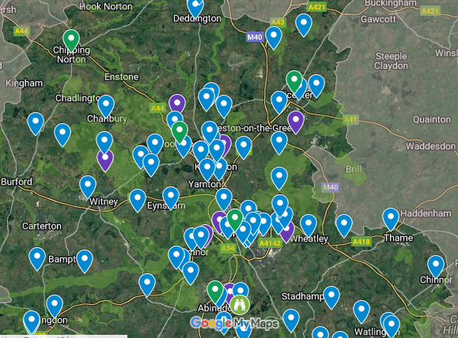
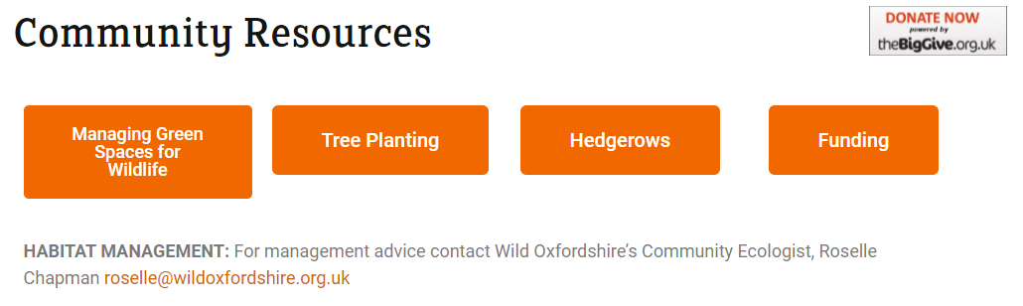
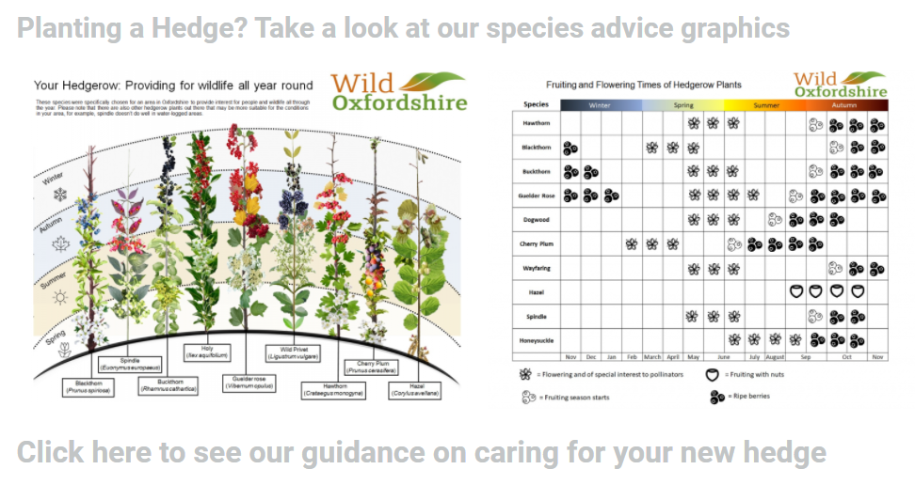
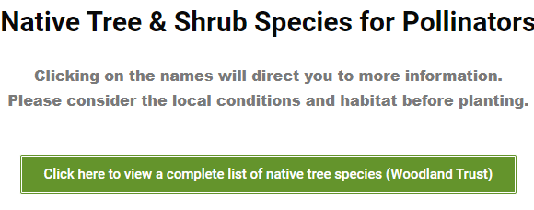
Resources for Communities
https://www.wildoxfordshire.org.uk/communities/resources/

Slide 20
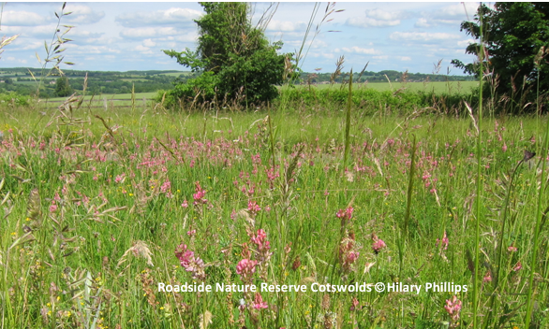
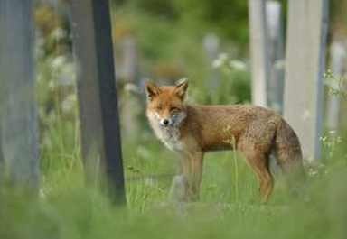
Examples from communities across Oxfordshire…
The floral diversity of nine Road Verge Nature Reserves and green spaces in West Oxfordshire have been enhanced through Wychwood’s Suck Seed & Sow Project
‍SS Mary & John Churchyard in Cowley is managed for people and wildlife through weekly volunteer working sessions. The churchyard supports a wide range of wildlife, providing it with a stepping-stone across the urban landscape.

Slide 21
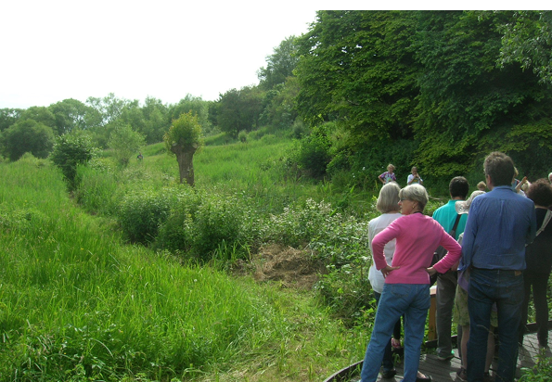
Examples from communities across Oxfordshire…
‍Horspath Conservation Area, is a Local Wildlife Site is established in the disused railway cutting and managed by volunteers.
‍Friends of Lye Valley, work to protect and preserve this internationally important SSSI for wildlife in the Headington area.

Slide 22
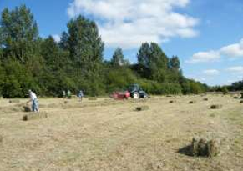
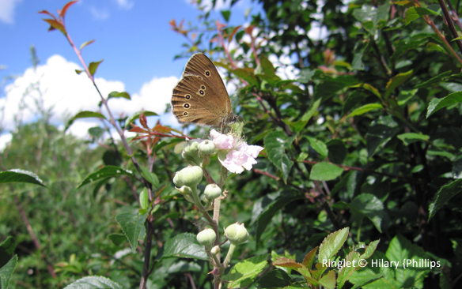
Examples from communities across Oxfordshire…
‍Friends of Barton Fields, manage this grassland and marsh situated next to the Thames in Abingdon and monitor their progress by recording species. A former Oxford City rubbish tip Astons Eyot is now a mosaic of habitats: some woodland (both plantation & self-generated) but most is open or scrubland.
‍Friends of Astons Eyot was formed in 2010 with a view to securing the Eyot’s future and avoiding both unsympathetic management and deterioration of the environment due to lack of any management at all.

Slide 23
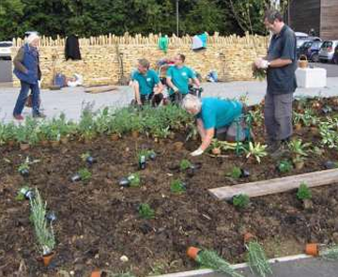
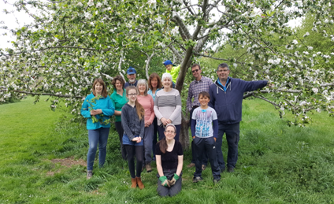
Examples from communities across Oxfordshire…
‍Chipping Norton Bumblebee Project A local group identified several potential sites including Chipping Norton School, the cemetery, a garden centre and the recently opened health centre to be ‘improved’ by establishing wildflower grasslands and ‘bee-friendly’ herbaceous borders.
‍Langford Community Orchard – nurturing an area of natural beauty and tranquillity, to enhance the range of plants and wildlife so that it’s an enjoyable place to spend time, have fun, learn, and relax.

Slide 24
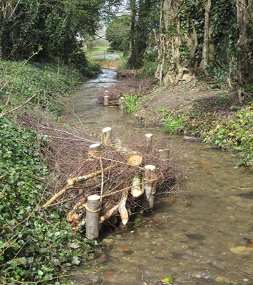
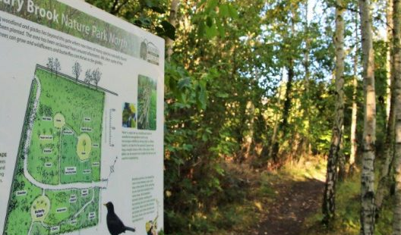
Examples from communities across Oxfordshire…
‍Watlington Environment Group – undertaking practical work to improve the water quality and support biodiversity and wildlife as well as raising public awareness of precious chalk streams. They are also conducting a parish hedgerow audit and have made a fantastic film about it.
‍Getting outside help for their ambitious conservation project on old allotments off Iffley Road in Oxford – Oxford Urban Wildlife Group

Slide 25
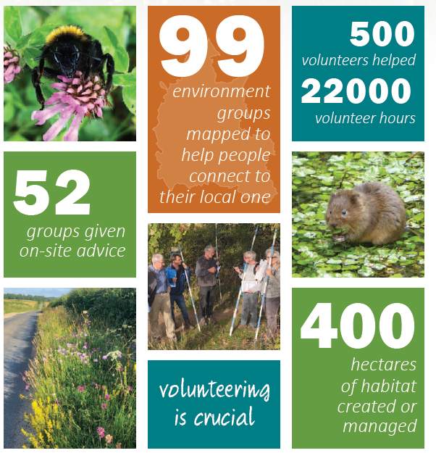
Does it work? Yes! In the last 5 years…
“Finding Wild Oxfordshire was our Bingo moment” Felicity, Green Appleton
“By connecting people living in the same place, all dedicated to protecting their local environment, we collectively make informed interventions” Catriona Bass and Kevan Martin Long Mead Local Wildlife Site, Eynsham
“Many individuals living with addictions come to the churchyard because they need the peace and tranquility that contact with nature provides.” Ruth Ashcroft, SS Mary & John Church

Slide 26
What’s needed?
Time - to fully reflect the needs and wants of the community and to find ways for inclusive and well supported actions
Support from outside agencies at the right times and for the right reasons.
Finance to manage assets and provide support.
“Community Ecologists are at their best when they have the capacity to invest in getting to know the local politics, the personalities, and what’s happening on the ground. It’s why there isn’t really a ‘manual’ that can replace the role.
Building up knowledge over time so there is longevity in understanding and relationships is one of the significant benefits.” Edel, Benson Nature Group
“Wild Oxfordshire is one of our key biodiversity partners. The delivery of the Council’s Community Nature Plan, which demonstrates that it is fulfilling its NERC Act duty, relies heavily on partnership work with this local, trusted and highly competent organisation.”
Cherwell District Council

Slide 27
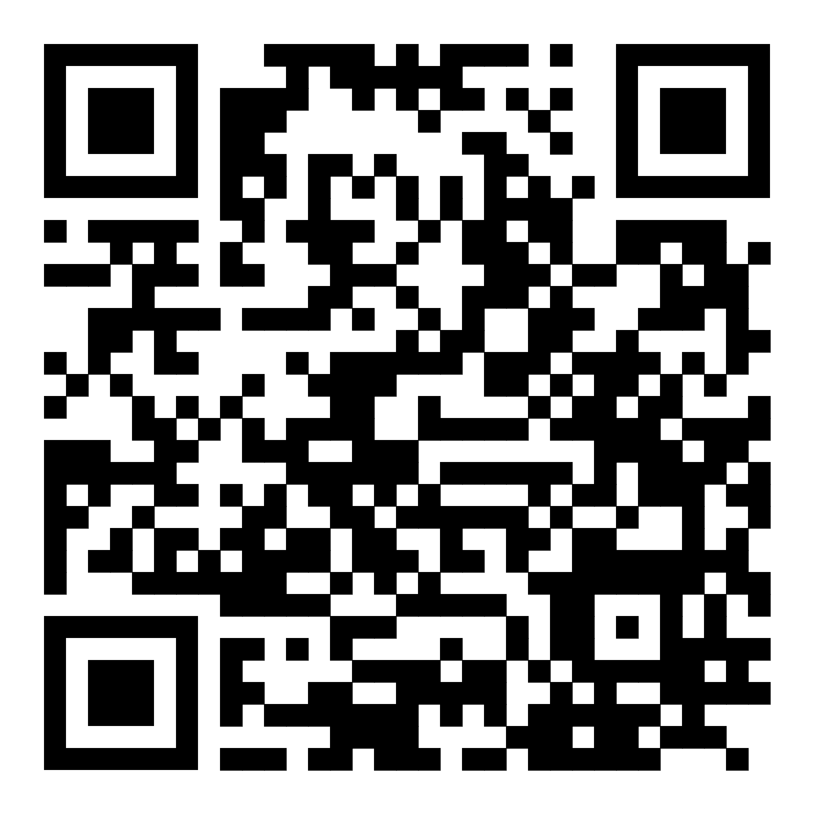


Let’s keep in touch
Stay up to date with Wild Oxfordshire:
  Website: www.wildoxfordshire.org.uk
  Twitter: @WildOxfordshire
  Facebook: @wildoxfordshire
  Instagram: @wild_oxfordshire
  Sign up for our monthly bulletin via our website or scan the QR code.
Support our work:
  Donate any time on our website
  Sign up to Give as You Life to raise funds whilst you shop
  Volunteer with us
  Spread the word of our work
  For other ways to support us, visit our website.
@wild_oxfordshire
www.wildoxfordshire.org.uk
@WildOxfordshire
@wildoxfordshire

