Slide 1



Slide 2
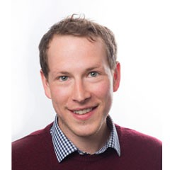
Today…
Introduce Bioregional and One Planet Living
Bioregional Homes
OPAL (One Planet Affordable Living)
Anthony Probert
Development Manager, Bioregional Homes
anthony.probert@bioregional.com

Slide 3
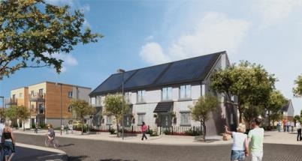
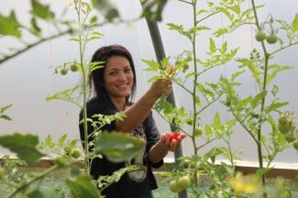
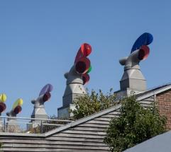
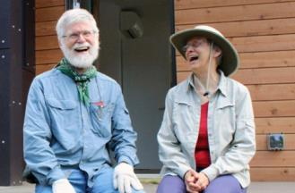
Introducing Bioregional
A leading sustainability charity and social enterprise established in 1994
We are absolutely environmental and committed to delivering leading, long term sustainability solutions
Sustainability plans for 150+ organisations & projects
Work across built environment, CSR & policy sectors
Practical & entrepreneurial

Slide 4
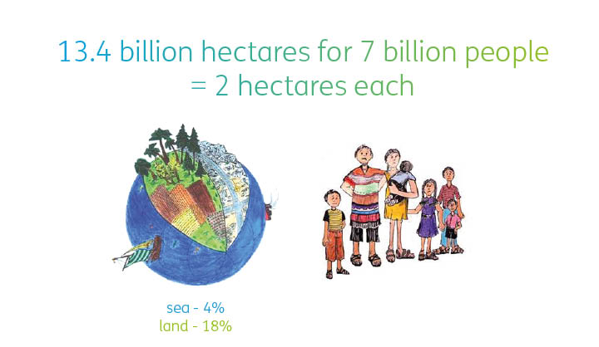
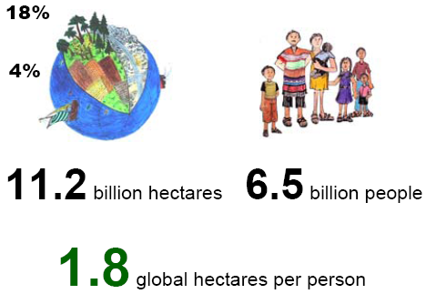
Our Ecological budget
12
7
1.7

Slide 5
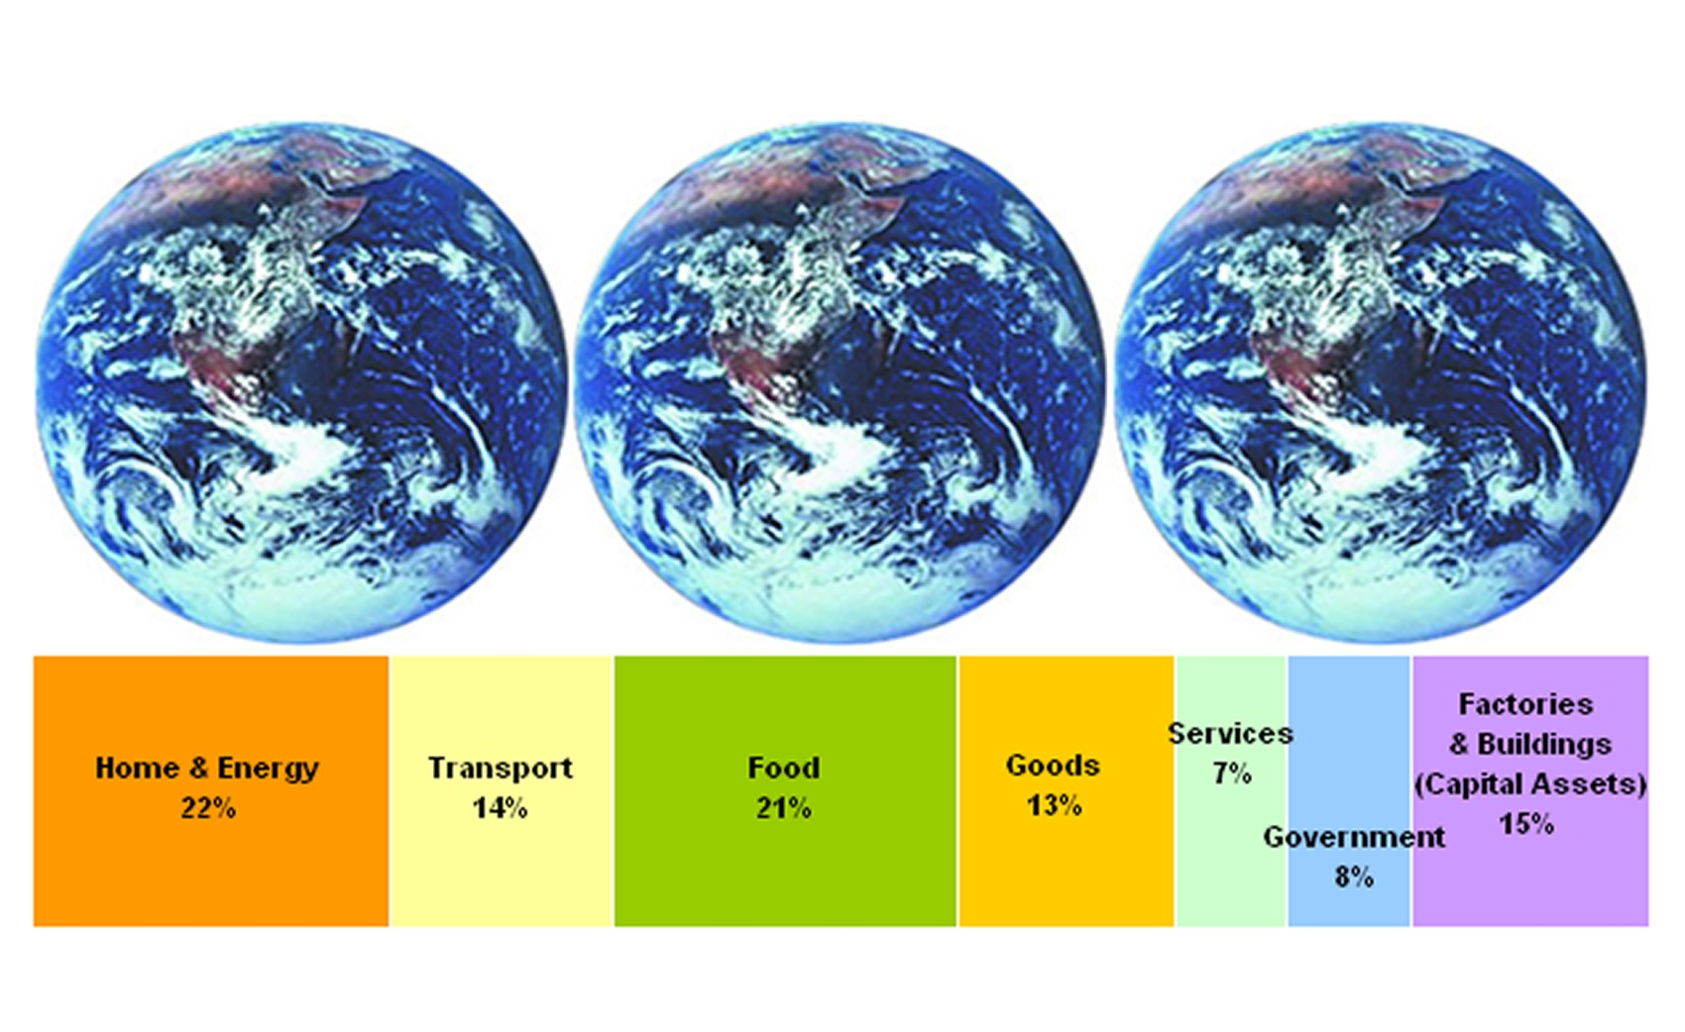
UK’s ecological footprint
Significance of ‘societal share’

Slide 6
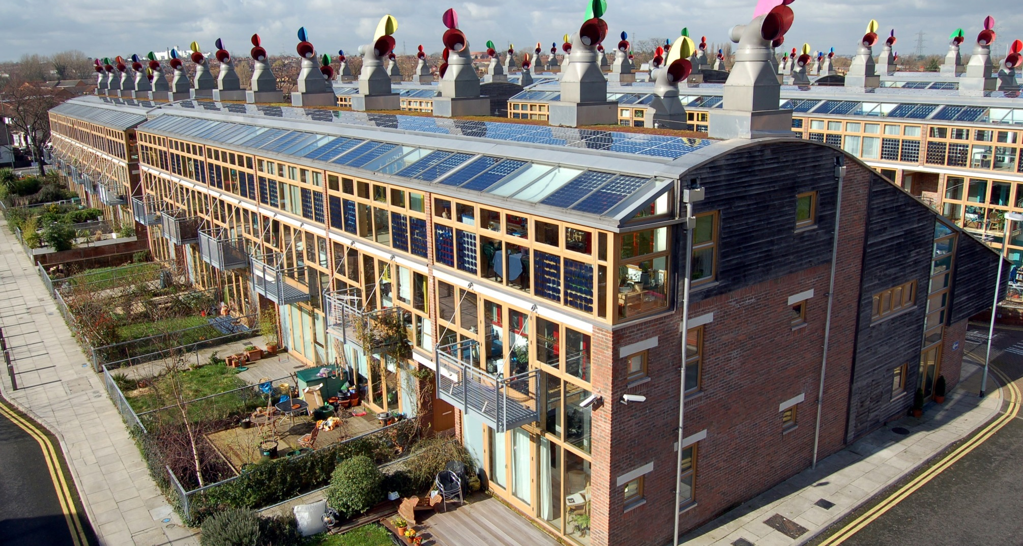
BedZED

Slide 7
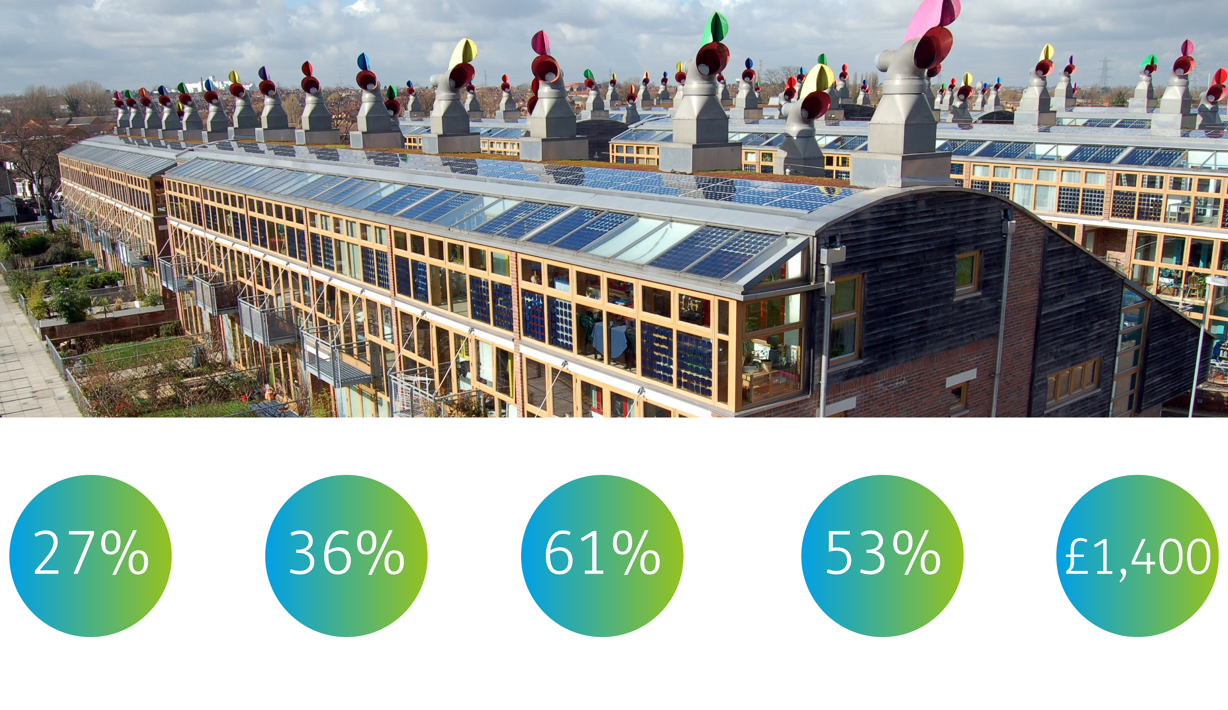
Less electricity use
Less gas use
Less water use
Less travel carbon
Saved in bills per year

Slide 8
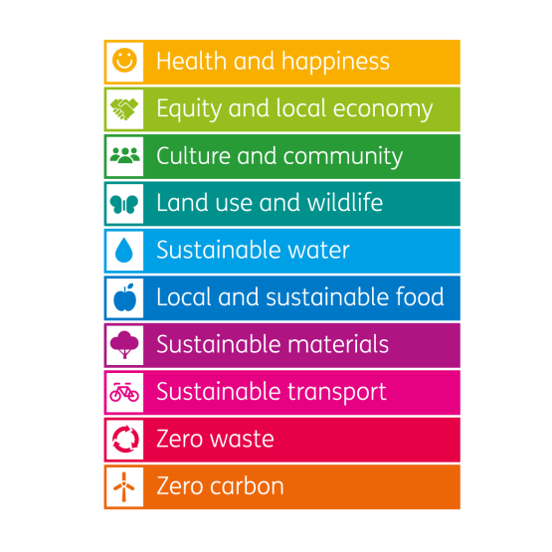


One Planet Living Framework
A world where we can live happy, healthy lives within our fair share of the worlds resources, leaving sufficient space for wildlife and wilderness.

Slide 9
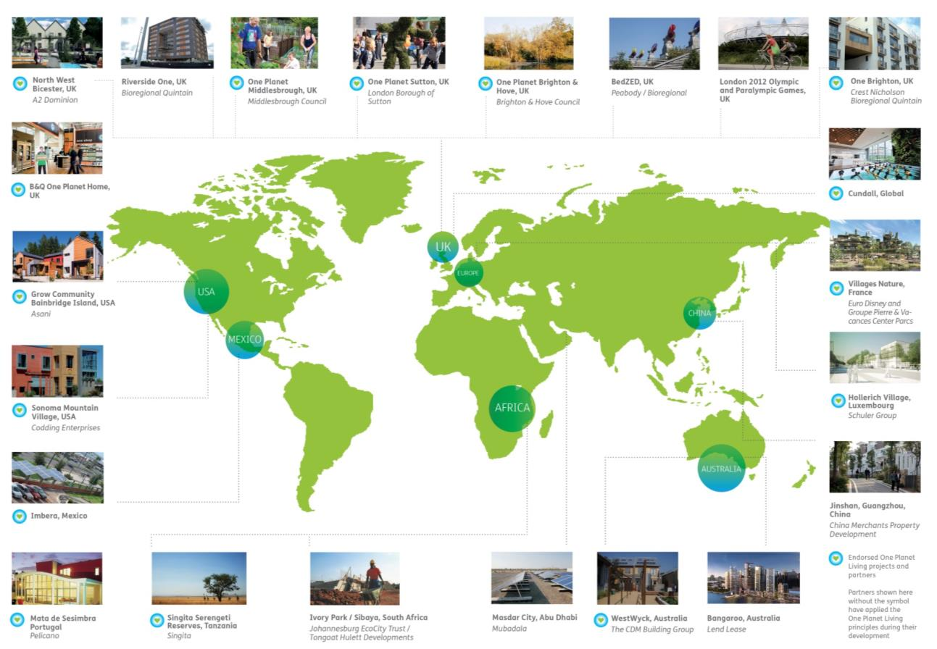
Notes:
We are working on projects and in partnerships on five continents, and we have representatives in the USA and Canada, Mexico, South Africa and Australia. In the UK we have offices in Bicester, Oxfordshire and Brighton & Hove as well as our head office in Sutton, south London.

Slide 10

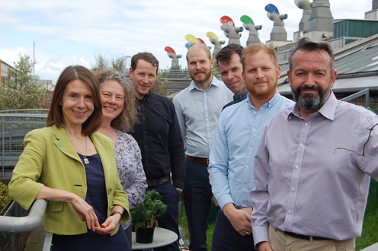
Wholly owned subsidiary of Bioregional charity
Acts as delivery partner for community housing groups
Homes priced according to local and key worker income
Land gifted to CLT/CIC to maintain affordability
Built to enable One Planet Living
3 projects in planning
6 others being nurtured

Slide 11
Mincing Lane, Chobham
Near Woking, Surrey
Rural Exception ‘developable’ site
Negotiated conditional contract
1.8 hectares, village fringe
Undertaken needs analysis with enabler
30 homes – 24 at discount to OMV
‘Living in the woods’
Establishing a CIC development vehicle
OPL plan developed with community
Charitable/private predevelopment finance
Planning by Dec 2018

Slide 12
Affordability analysis
Kings Langley, Herts
Open Market Value = c£450/sqft

Slide 13
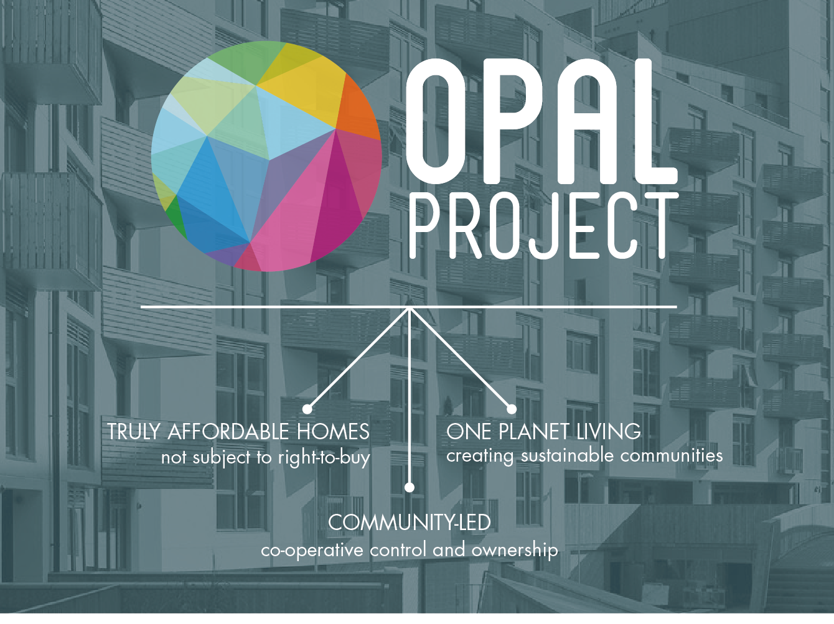

Slide 14
The OPAL project
There’s lots of community groups…
… but far fewer community housing schemes.
The OPAL project examined the challenges faced by groups looking to deliver their own sustainable homes.
The OPAL service provides groups with the skills and tools they need to overcome these challenges.

Slide 15
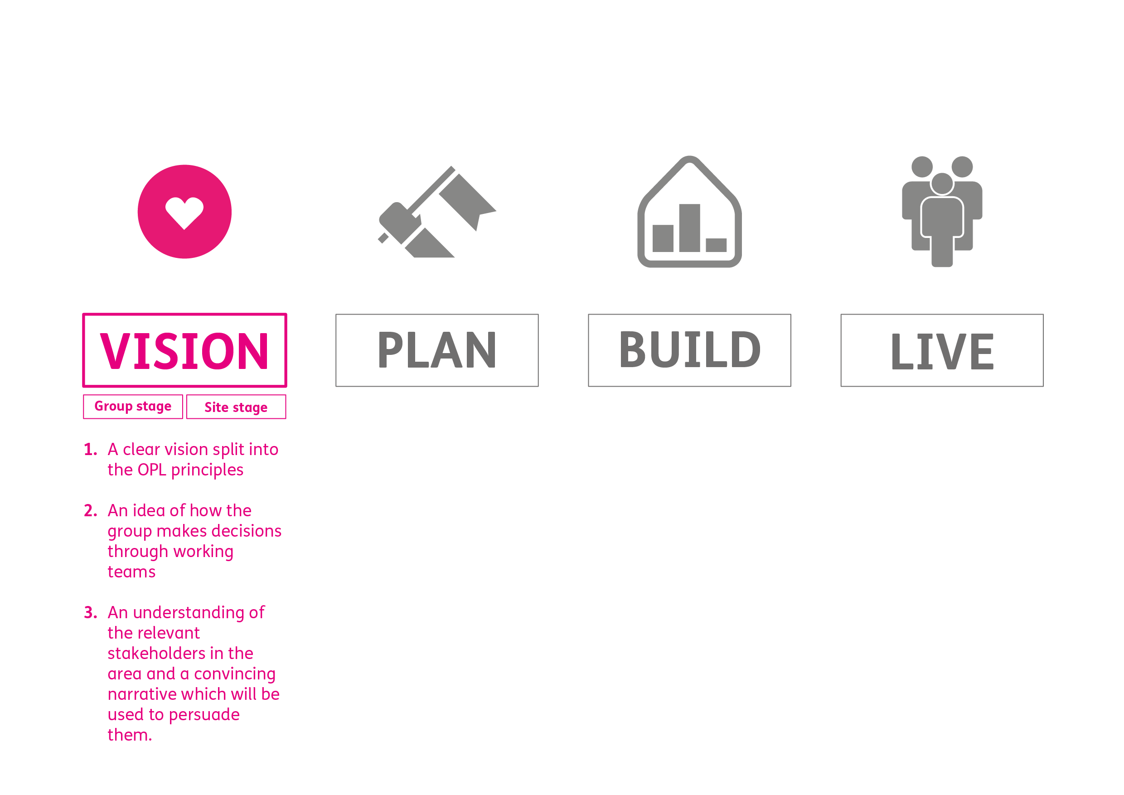
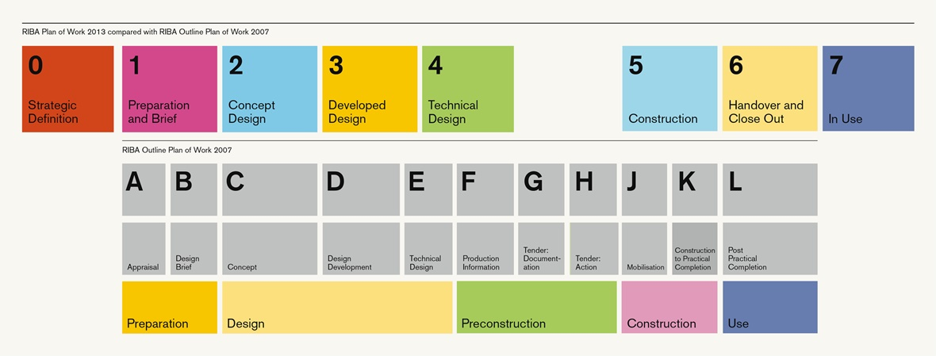
Unique purpose of the scheme
Group organisation
Stakeholder engagement
Fundraise - small

Slide 16
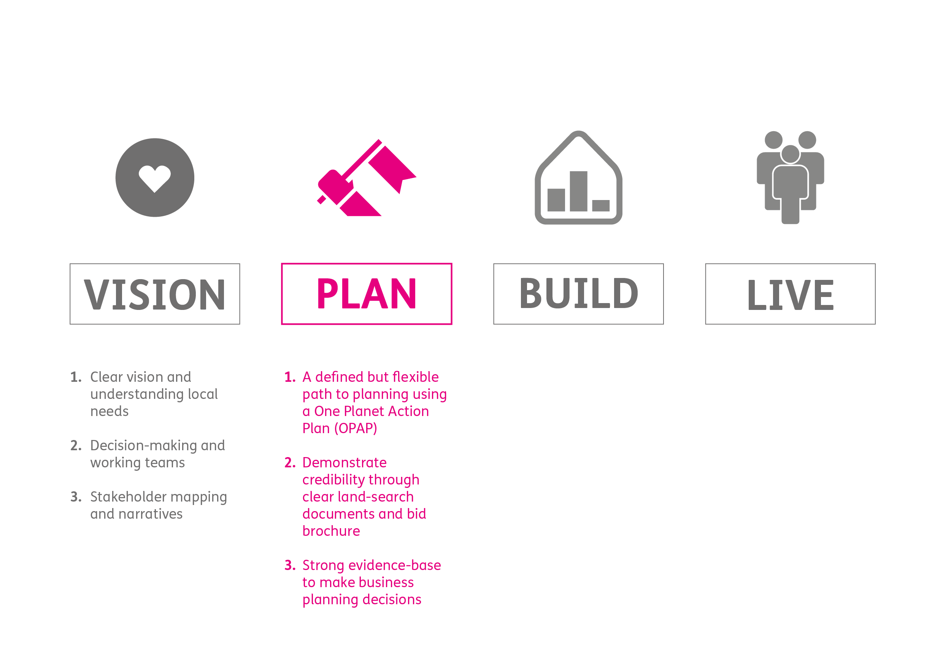
Unique purpose of the scheme
Organise group
Stakeholder engagement
Fundraise - small
Development brief – One Planet Living
Plugging the gaps
Land appraisal
Business plan
Fundraise - medium

Slide 17
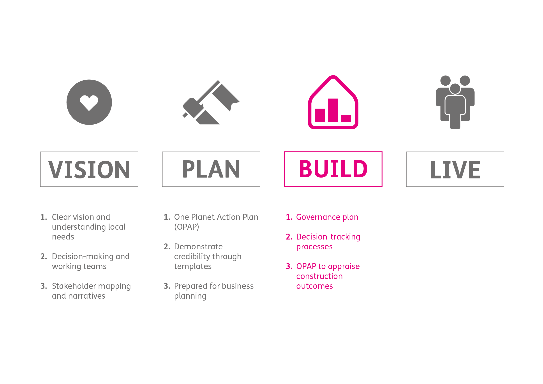
Unique purpose of the scheme
Organise group
Stakeholder engagement
Fundraise - small
Development brief – One Planet Living
Plugging the gaps
Land appraisal
Business plan
Fundraise - medium
Establish community governance
Track decisions
Revise & update plans
Fundraise - large

Slide 18
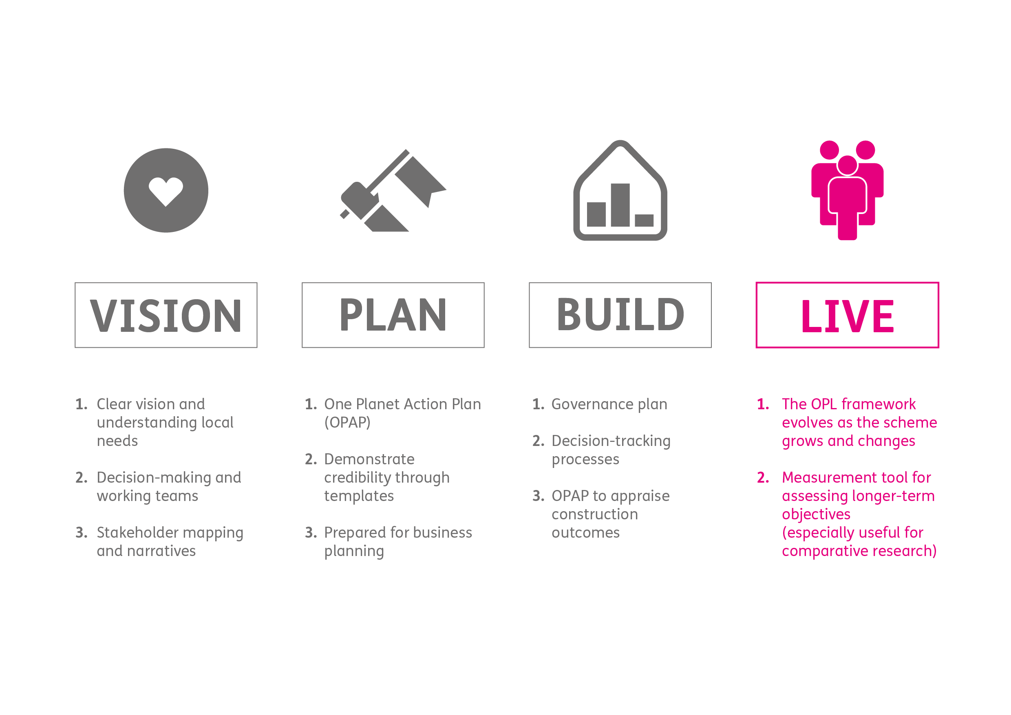
Unique purpose of the scheme
Organise group
Stakeholder engagement
Fundraise - small
Development brief – One Planet Living
Plugging the gaps
Land appraisal
Business plan
Fundraise - medium
Establish community governance
Track decisions
Revise & update plans
Fundraise - large
Monitor, measure and respond to needs
Communicate!

Slide 19
Stage 1: Vision
Workshop One – Building the Purpose:
Motivations
Affordability
Day in the Life
OPL Objectives
Core objectives
Workshop Two – Building the Group
Skills audit
Working teams
Good client
Workshop Three – Building the Message
Stakeholder mapping
Key messages

Slide 20
To summarise…
Bioregional work with community groups in two ways:
As developer (Bioregional Homes)
As advisor (OPAL)
With the aim of delivering projects that are truly:
sustainable
affordable
community-led
Thank you!
Get in touch:
www.bioregional.com
Anthony.probert@bioregional.com
0208 404 4880

Slide 21
Anthony Probert
Anthony.probert@bioregional.com

