Slide 1
What I know now……..
13th June 2018
Fran Ryan
Founder and Director OCLT and Oxford Cohousing

Slide 2
Intro
Housing activist since 2003
Sector currently small but its unique qualities and benefits mean it deserves support to become mainstream
Two case studies and lessons learned
Notes:
Acute shortage of affordable homes and spiralling housing costs
Founder member of OCLT in 2003 and Oxford Cohousing in 2010
C 2000 Martin Large returned from Churchill Scholarship in US researching CLTs there and brought back wonderful video which featured Burlington CLT which had been sponsored by Bernie Sanders then Mayor of Vermont
My motivation comes from the effects of housing costs on young people and young families: working so hard to pay impossible rents and mortgages v little time for other stuff. I want to get more TIME for people.

Slide 3
Dean Court
Notes:
Case Study 1 Dean Court
Got this land in 2010 through Quaker connections. Sale completed 2012 to Stonesfield Community Trust as OCLT couldn’t at that point fund it. No cred no track record.
LESSON: early stage CLH groups have zero cred so need to consider how best to manage that. Partnering an option but that’s tricky too.
Planning delayed by problems locally with Thames Water so only applied in 2015. Got PP June 2015.

Slide 4
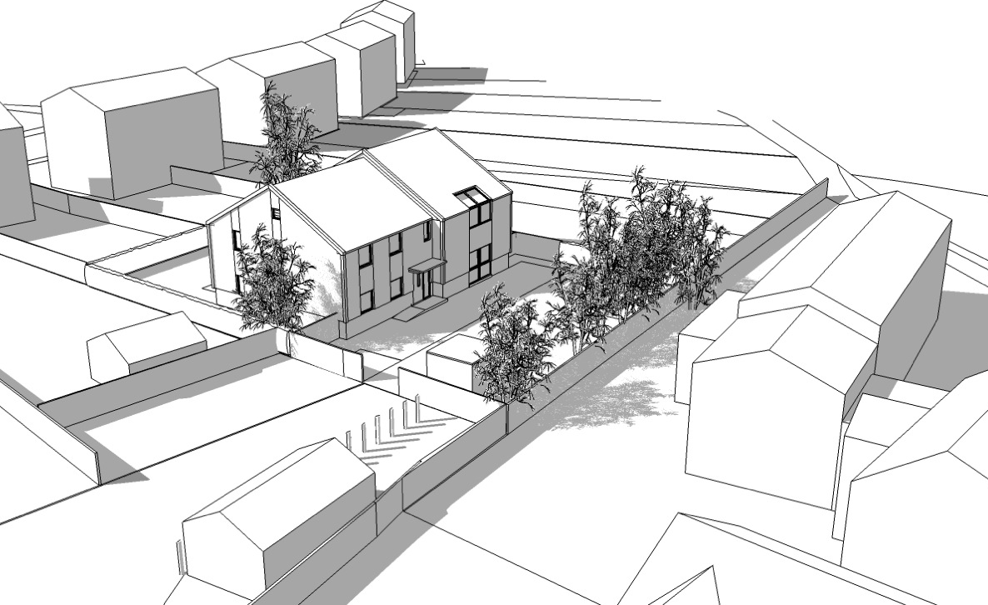
Dean Court
2015 planning consent
Notes:
Plans
Describe it. 2x2, 2x1 and 2 studios
Nominations through Vale Housing Register to people w local connection and who are willing and able to join together to run it as Housing Coop. The objective to build community as well as building homes.
No Right to Buy so will remain affordable in perpetuity. Critical that the affordables we build remain affordable.

Slide 5
Summary of Finance in 2015
£1.2m overall cost including land
£203 K from HCA
£750 from Resonance
£200K further grant funding
Income from affordable rents at LHA level
Notes:
Finance as above
Note that considerable grant funding needed even when land is relatively cheap. Basic equation is this: borrowing limited by rental income so anything above that needs to be grants. This is particularly taxing for small developments such as this when the (relatively high) infrastructure costs are only spread across a few units.
Problem: However: we hit problem delay in securing planning coincided with steep rise in land/house prices.
New lawyers for SCT, new culture and the advice was that they’d be in breach of Charity Law if they sold to us at £195K when it was worth three times that (largely because we had got planning). Project put on HOLD in March 2015.
Three years on and CC recently issued order for sale at below market value with an overage clause to protect them in case the development doesn’t happen.
LESSON: Get CC to accept overage clauses more easily as a means selling land to CLH groups while also protecting the charities.

Slide 6
Dean Court Latest News
About to complete on sale enabled by soft loan
Appointed new architect and got plans ready to go
Two other donations enabled appointment of paid project manager who has really speeded things up
Notes:
LESSON: Soft finance essential for starting up and getting to planning. Locality useful and gave OCLT £10K when we did Irving

Slide 7
Latest Design
Notes:
New design more contemporary.
8 units. Nominations as before.
We are hoping to get this through but it will be a test. Strong support from Parish Council, local members and some of the local community.
Some neighbours want more affordable homes but not in their back yard.

Slide 8
Wolvercote proposal (May 2016)
Notes:
Case Study 2
Wolvercote Paper Mill
Good example of what communities can do
OCLT worked as a part of Homes for Oxford and with other organisations to make bid. Oxford Cohousing Kindling Coop and several others. (Kindling have since secured their first coop owned and managed house for 8 people to rent affordably).
260 mixed tenure homes. One third OM, one third IM, one third SR.
Two thirds affordable the ambition being for none of them to have RTB. So two thirds permanently affordable and restricted to those on lower incomes
Built in clusters to engender mutual support and good neighbourliness. 2 cohousing groups.
LESSONS:
Enablers: Free CAG Meeting space enabled lots of meetings to draw groups in and bring bid together
Soft funding to enable some of the design work.
Enabled considerably by Oxfordshire Community Foundation who managed the Just Giving page for HfO and drew in £.5m in one week in run up to submission of bid
Lack of cred and track record undoubtedly contributed to this imaginative bid not being short listed.

Slide 9
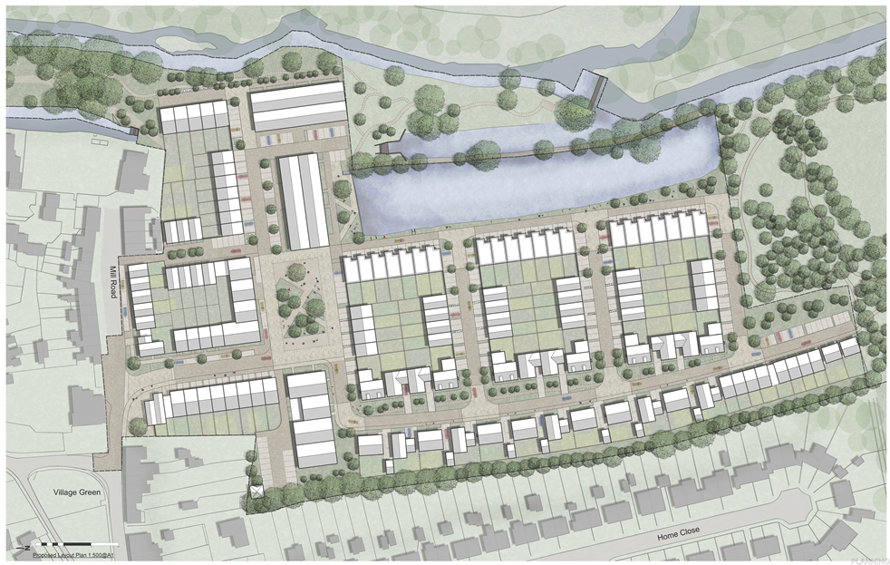
Cala Master Plan
Notes:
190 homes 310 cars
Affordable sizes smaller than OM
Affordables mostly in apartment blocks
Some very large houses

Slide 10
Illustrating the Differences
 | Developer | CLH
Price to landowner | £22m+? unconditional | £17m- conditional
Density | 190 | 260
Tenure mix | 50/50 | 34/33/33
%affordable | 50% | 66%
Permanently affordable | ? | 66%
Configuration | Conventional | Clusters
Cars | 310 | 195
Floating homes | No | Yes
Shared green space | A little | A lot
Community involvement | Some | Fundamental
Notes:
Lessons:
Landowners get less cash( but more other benefits) from CLH. 20-25% less in this case.
Developers pay too much for land and must not be allowed to use viability arguments to get out of affordable quotients.
CLH can do permanent affordability because of i) CLT ownership of land and ii) coop leases so this ensures mixed communities with homes for people on low and average incomes.
CLH build for community: far fewer cars and cars on outside, very good for old people and children especially.
Social and environmental returns look more likely with CLH and this needs to be measured.
Most clear benefit: a permanently affordable home results in permanently lower rents and therefore less call on Local Housing Allowance. The sale of over 1m council houses since 1980 had led to a big increase in housing benefit.
Sprigings estimates (2012) upwards of £1b extra pa in HB to ex council stock now in PRS
2012 Joseph Rowntree Foundation: HB support to PRS £7.6b pa. Much higher now. THE BIG ISSUE: Why is no one talking about this and the fact that a big driver to have more affordabe homes is to reduce the burden of unaffordable rents to tax payer? We have more urgent things to spend money on than paying into private landlord pockets.

Slide 11
Summary of learning
Seek off-market deals
Get better at quantifying and presenting the benefits of CLH
Develop relationships w partners
Promote what has been done so far: Stonesfield Community Trust, Kindling Coop.
Secure soft funding to get started
Notes:
LESSONS:
CLH can’t afford to bid against developers (who frequently pay too much for land to be able to meet local affordable housing policy requirements)
CLH need to get better at quantifying the benefits esp around potential savings to tax payer in LHA.
Some have worked with developers and/or Housing Associations as partners but this isn’t ideal.
Promote success stories…..
Secure soft money to get started.

Slide 12
What’s needed nationally…..
Secure better policy support for permanently affordable CLH
Secure set up of revolving loan fund such as The Scottish Land Fund
Work out how to get exclusive access at fair price to charitable and publicly owned land
Notes:
NEF working on how to persuade local authorities to privelege CLH groups when disposing of land.

