Slide 1
Enabling community-led housing Fiona Mullins

Slide 2
Definition
community engagement and consent
community owns, manages or stewards
benefits clearly defined and legally protected
Notes:
“meaningful community engagement and consent occurs throughout the development process. The community does not necessarily have to initiate and manage the process, or build the homes themselves, though some may do;
the local community group or organization owns, manages or stewards the homes and in a manner of their choosing, and this may be done through a mutually supported arrangement with a Registered Provider that owns the freehold or leasehold for the property; and
the benefits to the local area and/or specified community must be clearly defined and legally protected in perpetuity.”

Slide 3
Community Land Trust
affordable in perpetuity
asset lock
avoid right to buy
Housing Co-operative
Cohousing
Governance principles
Design form
Community process
Self or custom-build
Tenancy self-management
Build method (self or commissioned)
Governance approach
Notes:
In practice, community-led mechanisms are often used in combination.
A scheme may be held in a community land trust to lock in affordability in perpetuity, the layout of the dwellings and common spaces may be designed according to co-housing principles, and the scheme may be managed according to co-operative or tenancy self-management principles.
Wide range ... but what we mean by “community-led” is:
community must be integrally involved throughout the process;
community groups that are taking a long term formal role in ownership, management or stewardship of the homes; and
benefits to the community clearly defined and legally protected in perpetuity.
Different schemes tend to look to one or other of the mechanisms as their primary motivation and each mechanism has its own set of national advisory bodies, literature and networks.
Eg Oxford cohousing scheme aspires to meet CLT principles, aims to have some tenancy self-management and self or custom build, but willbe governed as a housing co-operative, has had most of its advice from the national body the confederation of cooperative housing and it incorporated using model articles provided by Coops UK.

Slide 4
Oxford Community-Led Housing: routes to delivery

Slide 5
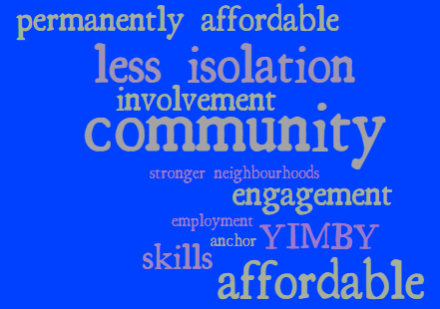
Benefits
Notes:
Stronger neighbourhoods
Less isolation
Involvement
Permanently affordable
Community anchor
Skills development
Local support

Slide 6
Investing
homes well-being quality, long-term
Why Community-led?
Positively value
affordability community facilities social features environmental features
Notes:
Stronger neighbourhoods
Less isolation
Involvement
Permanently affordable
Community anchor
Skills development
Local support

Slide 7
Is community-led housing feasible?
scales
tenures
contexts

Slide 8
Does community-led housing need support?

Slide 9
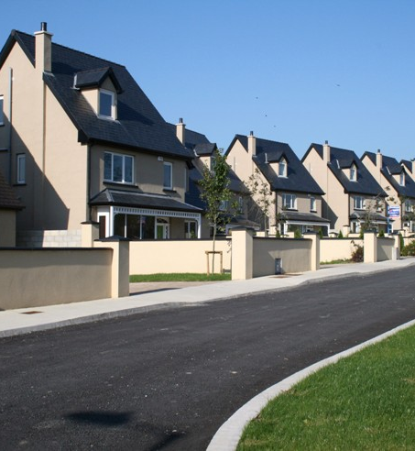
will
always
win
Notes:
Large development companies have skills, finance to deliver housing
Generate a pipeline of housing schemes, land banks
Developers compete against one another to offer the highest upfront sum to the landowner, based on assumptions of how many homes they can build, how much they can sell them for, and how much they’ll be expected to contribute to the community in the form of affordable housing and infrastructure. Whichever firm is able to squeeze its costs the most is able to pay the most for the land.
lies at the heart of the affordability issue
Because the landowner naturally goes to the highest bidder, the developer has a strong incentive to cut affordable housing and community infrastructure. Competitive pressure also can result in homes that do not take account of total cost of ownership, energy efficiency and comfort.
From their perspective,
Want a replicable pipeline of housing schemes
Large better than small
Less complexity
Faster

Slide 10
Notes:
Anyone can buy a plot of land, build on it, allocate or sell homes, and manage a housing scheme. There is nothing special about the feasibility of CLH. Housing schemes are more complex than normal householders can deliver on their own but the necessary expertise can be paid for.
However there are many barriers for CLH groups to overcome
CLH groups are inexpert / inexperienced clients. CLH groups lack credibility and sufficient track record particularly for a large scheme
Lack capital reserves to accommodate overruns or make unconditional bids
Low standardisation / replicability across projects.
High communication overheads (multiple perspectives and expectations, especially in groups)
High per-project overhead costs (for example professionals’ fees, meeting regulations, site preparation etc) in both time and money.
There are high levels of risk / cost uncertainty in the development process, which are better by a well-capitalised organisation.
Low trust / lack of transparency in the process.
Low skills in local trades, resulting in poor quality construction, difficult to manage
Large organisations such as housing associations, housing companies can work successfully with community groups to deliver community-led homes.
Community Led Housing will not replace mainstream housing provision, but it can be part of the mix of solutions to deliver more homes as well as the normative qualities that people need from housing.

Slide 11
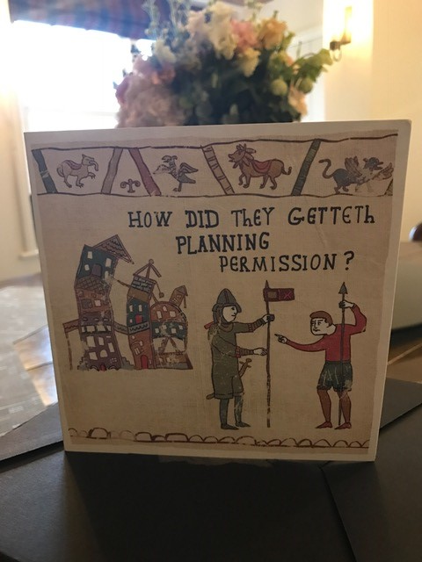
Notes:
Community-led approaches are not expanding easily or naturally in the fierce competition for land.

Slide 12
What support is needed?
Access to land
Finance
Professional help
Notes:
Land issues: Community-led housing groups are not succeeding in the competition for sites against larger organisations with financial reserves and developers with both expertise and access to finance. The requirement for public bodies and charities to get best value or best consideration is almost always interpreted as having to take the highest price that is offered for land so the additional social, environmental and economic benefits that community-led approaches bring are not considered to be relevant in bidding for land.
Finance issues: Oxford groups have managed to find pre-development funding on the scale of tens of thousands “at risk” to get to the stage of bidding for a site, although this is very challenging. Community-led housing bids in Oxford have had to be ‘conditional’ as community groups cannot take on the risk of not getting planning permission. This puts them at a disadvantage in the intense competition for sites. Community-led housing groups also lack credibility and sufficient track record of development which is a handicap when seeking finance and partners particularly for a large scheme. However community-led housing groups have been successful in accessing different finance avenues such as philanthropic and crowd-funding.
Support. Oxford community-led housing groups reported challenges in their own processes such as high group expectations about what will be possible and naivety about the development process. The amount of work involved is enormous for volunteers and very few people are prepared to lead such a process on the margins of busy lives. the expertise that is needed can be commissioned . Groups that partner with a developer or large institution can benefit from their partner’s in-house expertise and access to finance but may need to support to be effective partners in order to influence the scheme.

Slide 13
National bodies
Housing professionals
Partnerships or joint ventures
Councils
Sources of support

Slide 14
Planning policy
Planning control
Housing company
Estates team
Empty Homes
Councils

Slide 15
Awareness
Replicable models
effective community organisations
Notes:
The outreach for this study showed that very few people know about community-led housing. But when spoken to, many people were enthusiastic about community-led approaches for their own housing. Community-led solutions have many benefits that strike a chord with people including genuine affordability in perpetuity, individual well-being and supportive neighbourhoods.
Many housing professionals including in the housing company, registered providers and some development companies have some awareness of community-led housing but need replicable proven models in order to engage as partners in community-led housing schemes.
Many other professionals who community-led housing groups approach such as accountants, lawyers, land agents and viability experts are unaware of community-led housing and need general introduction to the mechanisms and examples of how they can be delivered.

Slide 16
Notes:
The third sector is also an important source of neutral support. The advisory support function that has been established in Oxfordshire - “Collaborative Housing” - is working in partnership across organisations and with a range of local experts to support community-led housing groups, local authorities and developers.
Community First Oxfordshire, Oxfordshire Community Land Trust and potentially other partners are initiating a service to deliver enabling services locally and available to groups across the Thames Valley through local partners in each area.

Slide 17
Contact
Fiona Mullins Development Project Manager
fiona.mullins@communityfirstoxon.org 01865 883488

