Slide 1
Understanding the Community Housing Fund

Slide 2
Community Housing Fund 2016
£60 million annual fund for affordable homes
Year 1
23rd Dec – 31st March
Year 2
2016
2017
2018
2019
2020
Notes:
Read Jo Lavis and Tom Chance review for Power to Change on this

Slide 3
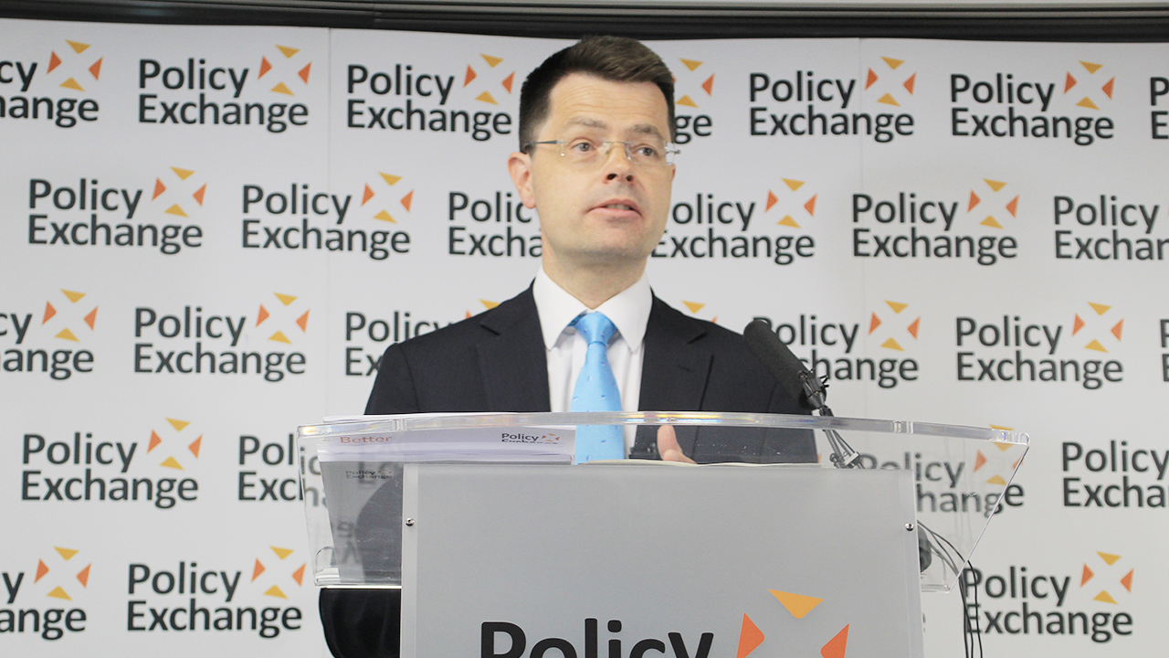
Community Housing Fund 2018
£163 million for affordable homes

Slide 4
Community Housing Fund 2018
£163 million for affordable homes
Year 1
23rd Dec – 31st March
Year 2
Year 3
2nd July – 31st March
Year 4
1st April – 31st March
END
2016
2017
2018
2019
2020
Applications portal
open to 31st Dec 2019

Slide 5
Community Housing Fund 2018
Phase 1 – Group revenue
Capacity-building, project-specific professional fees and costs, planning applications, business planning and project management
Eligible bodies (RP not necessary)
Follows milestones
10% funding from elsewhere
Phase 1 – Local Authorities
Staff costs for assisting groups and identifying potential demand or sites
Capital costs for infrastructure
Access roads/roundabouts
Site remediation or flood attenuation
Utilities
Notes:
Capacity-building, including seedcorn funding to get started.
Project-specific professional fees and costs, including feasibility work, design work.
Planning applications, business planning and project management
Eligible bodies
Follows milestones

Slide 6
Phase 1 – Revenue Grant Self-certified milestones
1 – Group <25% allocation
Incorporated with summary/outline of proposed project
2 – Site <50% allocation
Initial community housing proposals developed
Outline business / finance plan
Viability / feasibility assessment
Site identified
3 – Plan <90% allocation
Progress on developing community-led housing proposals
Results of feasibility study into identified site
4 – Detail >10% allocation
Planning consent and building control consent established
Detailed design drawings produced

Slide 7
Community Housing Fund 2018
Phase 2 – Capital Grant
Homes which are locally-affordable in perpetuity for those whose needs are not met in the market
Low-cost rental must register with Homes England
LAs and RPs can apply on behalf of community groups
Additional to s106 requirement and cross-subsidy encouraged
Value for money and Deliverability key criteria for award
LA support, site suitability, planning status, community support, group capaticy and progress to development.
Notes:
Value for money is grant per unit relative to other CLH bids plus lower total grant requirements bu finding project cost elsewhere
the degree of support from the local authority; the availability of a suitable site; planning status (e.g. planning permission); and the degree of engagement by the local community. Projects which have progressed furthest towards the development phase are likely to be able to make the strongest case for funding on deliverability grounds.
46. The assessment of bids will also take account of the capacity of the group to deliver the project. Projects which have progressed furthest towards the development phase are likely to be able to make the strongest case for funding on deliverability grounds.

Slide 8
Phase 2 – Capital Grant Homes England certified milestones
1 40% allocation
Acquisition
Unconditional secure legal interest in the land (freehold or long leasehold)
2 35% allocation
Start on site
Entered in to a building contract
The building contractor takes possession of the site or property
The works have commenced
3
15% allocation Internal fit-out Date when the internal fit-out of the homes has been completed
4
10% allocation
Practical Completion
All homes on the scheme have been completed and fit for occupation
Notes:
Unregistered bodies can get 100% on practical completion a first Fixed Charge over land, a Guarantee or a Performance Bond - each to at least the value of the funds advanced
The provider and the building contractor have entered in to a building contract
The building contractor takes possession of the site or property
The works have commenced Outline business / finance plan

