Slide 1

Making it Happen
Fiona Mullins

Slide 2
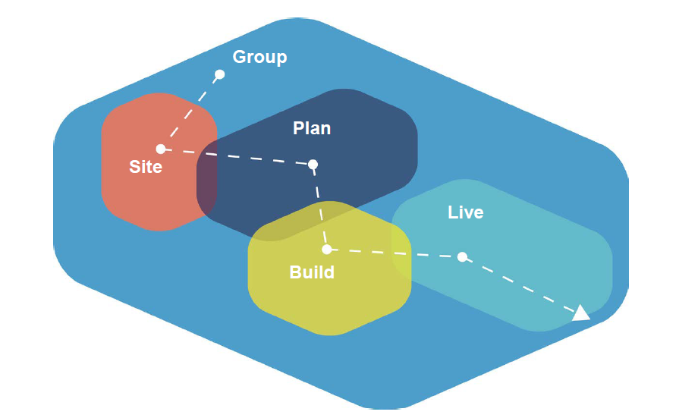
Pathway
to delivery
Source:
National CLT network
Notes:
CLH: the delivery “journey” does not begin with buying a site or end when a buyer purchases his or her home. Delivery involves everything from group formation to living in a community-led housing scheme including ongoing management and governance.

Slide 3
Community Land Trust
affordable in perpetuity
asset lock
avoid right to buy
Housing Co-operative
Cohousing
Governance principles
Design form
Community process
Tenancy self-management
Self or custom-build
Governance approach
Build method
(self or commissioned)
Notes:
Different schemes tend to look to one or other of the mechanisms as their primary motivation and each mechanism has its own set of national advisory bodies, literature and networks.
In practice, community-led mechanisms are often used in combination.
A scheme may be held in a community land trust to lock in affordability in perpetuity, the layout of the dwellings and common spaces may be designed according to co-housing principles, and the scheme may be managed according to co-operative or tenancy self-management principles.

Slide 4



Oxford Community Led Housing: routes to delivery
Draft report July 2018
Final report December 2018
Notes:
This study aims to explore how community-led housing could be delivered sustainably within Oxford City.
The objectives of the study are to show how community-led housing can contribute to meeting Oxford’s housing needs, to identify feasible routes to delivery in Oxford and the support that is needed to unlock the delivery of more community-led housing projects.
Study partners
Report later in the year
Can share the insights from interviewing community-led housing groups, housing professionals, council officers

Slide 5
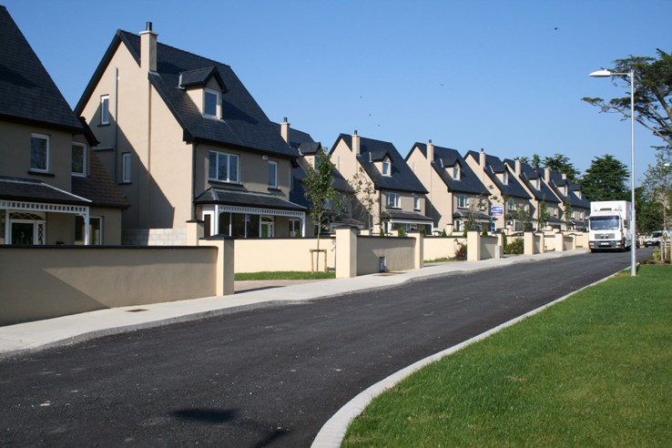


Housing professionals
Notes:
Large development companies have skills, finance to deliver housing
From their perspective,
Want a replicable pipeline of housing schemes
Large better than small
Less complexity
Faster
These things are realistic pressures for community-led schemes also, ideally wnt lower cost, simpler, faster process.
However, where there is competitive pressure the standard developer model will always out-compete a community led approach
Large organisations such as housing associations, housing companies can work successfully with community groups to deliver community-led homes

Slide 6

Community groups
Notes:
Community groups want a wider range of things and the homes they want are often nothing like the replicable pipeline that housing developers need.
The benefits of community-led housing are multi-dimensional:
Stronger neighbourhoods, neighbouliness, citizen engagement, addresses isolation
Greater local accountability and control over housing management:
Involvement at the design stage leads to tenure, type and size people need.
Permanently affordable
Community anchor functions, services, facilities, Skills
Parvin: investing in homes as long term places to live citizen developers see quality and sustainability not as costs, but as investments.
The distinctive financial and governance arrangements of community led housing approaches positively value affordability, community facilities, quality and social and environmental features rather than seeing these as costs. Community-led schemes typically require community facilities in the very nature of their design and ethos. quality of construction and environmental factors are weighed against not only the upfront costs but also the impacts on the well-being and ongoing living costs.

Slide 7

Notes:
Anyone can buy a plot of land, build on it, allocate or sell homes, and manage a housing scheme. There is nothing special about the feasibility of CLH. Housing schemes are more complex than normal householders can deliver on their own but the necessary expertise can be paid for.
Barriers
Inexpert / inexperienced clients
Lack of capital reserves to accommodate overruns
Low standardisation / replicability across projects.
High communication overheads (multiple perspectives and expectations, especially in groups)
High per-project overhead costs (for example professionals’ fees, meeting regulations, site preparation etc) in both time and money.
High levels of risk / cost uncertainty in the development process, which then needs to be borne by a well-capitalised organisation.
Low trust / transparency in the process.
Low skills in local trades / communities, resulting in poor quality construction.
Cost of labour and difficult, unreliable building methods.

Slide 8
Adapted from Nabeel Hamdi “Small Change” Earthscan 2004

Slide 9



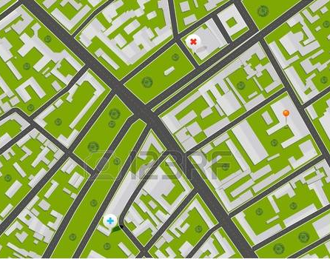



GROUP
FORMATION
DESIGN and PLAN
FIND A SITE
ONGOING
MANAGEMENT
BUILD
Notes:
Support needed at every stage of the CLH development pathway
A 2017 UK study concluded that advice and support services are needed to enable community-led housing. The report concluded that the range of key skills and expertise that groups need includes:
Explaining the different routes to achieving community‐led housing;
Facilitating the identification of the appropriate legal structure for the group;
Supporting groups with feasibility studies, housing needs surveys and business planning;
Providing information and advice on funding, finance, land acquisition, asset transfers, housing development and management;
Providing training on governance, management and community organising;
Providing access to a range of (accredited) technical support professionals
Acting as an intermediary between professionals/local authorities and community groups to facilitate understanding, constructive discussion and decision making

Slide 10


www.collaborativehousing.org
Notes:
Community First Oxfordshire, Oxfordshire Community Land Trust and potentially other partners are setting up a Hub called Collaborative Housing to deliver these enabling services locally. The services could be available to groups in neighbouring counties through local partners in each area.
Webinar 27th June 12-1 – see leaflet

Slide 11
Contact
Fiona Mullins
Development Project Manager
fiona.mullins@communityfirstoxon.org
01865 883488

